Slide 1

Lakeside Nursery

Slide 2
Our Nursery
We are a happy, busy, multicultural, multi-faith, nursery
We are fully inclusive - we celebrate our many cultures, and foster positive relationships with our children and their families

Slide 3
Our Staff
Our Head teacher is Mrs Rachel Mitchell
Our Foundation Phase Leader for Early Years is Mrs Lisa Rayer
Our Nursery teacher is Mrs Sam Goddard
Nursery is supported by a team of teaching assistants
We have some 1:1 support staff for children with specific needs

Slide 4
Admissions to Nursery
Nursery admissions are managed by the Admissions Team at County Hall
We have three intakes – the September, January or April after your child’s 3rd birthday
Nursery is not catchment dependant, but reception is
Admissions can be contacted via Cardiff website or phone 02920 873816
Wrap around care – Dragonflies 02920 864780

Slide 5
Transition Process
Nursery is a new adventure for your child! We take the transition process seriously and believe it cannot be rushed.
We will support you and your child by offering a ‘Stay and Play’ session in Nursery, prior to the Summer holidays.
We will also stagger the entry of children – 4 per day until all are in.

Slide 6
How can you help to prepare your child for Nursery?
Help them to develop their independence e.g. begin taking their coat on and off
Toileting – we would encourage you to toilet train your child before they begin Nursery. We are happy to support you in this, and are used to dealing with toileting accidents. You may wish to send in spare clothes in a bag in case of accidents, however, we do have spare clothes here if need be
Encourage them to use their own name
Give them opportunities to play with other children of their own age, so they can begin learning to share and take turns
Support them to sustain their listening for increasing periods of time, e.g. by sharing stories

Slide 7
Our Curriculum
Our curriculum is delivered through topics which change on a half termly basis
Our topics for the year are as follows:
- Autumn 1 - How many colours in a rainbow?
- Autumn 2 - Exploring autumn
- Spring 1 - Winter wonderland
- Spring 2 - Signs of spring
- Summer 1 – Are eggs alive?
- Summer 2 - How high can I jump?
Activities are carefully planned, resourced and varied. Children learn through play based activities, many of which are recorded in ‘Busy Books’

Slide 8
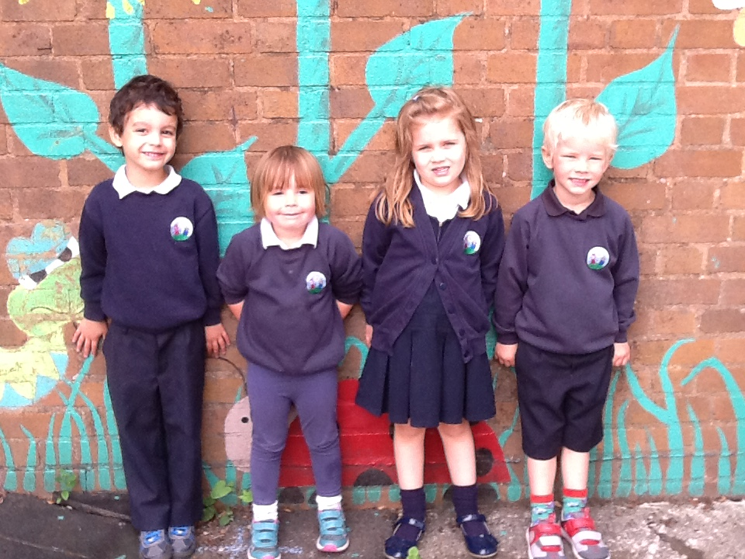
Our Nursery Uniform
Navy and white, with our own nursery logo
Trousers or skirts that are easy for the toilet!
Sensible shoes suitable for lots of activity inside and out
Everything clearly labelled please!
Available from YC Sports, Crwys Road

Slide 9
Snacktime
We provide a healthy snack and a drink during the nursery session – mainly fruit and vegetables, milk and water
The cost is £1.40 per week, which can be paid termly or for the full year
Specific allergies can be catered for – please inform staff if your child has any allergies
An opportunity for social development, trying new tastes and textures, taking turns, Welsh
Please don’t send food into school unless your child has a particular dietary requirement and it has been agreed with Nursery staff in advance

Slide 10
Drop off and Pick up
Please come to the back Nursery door. It will open at 9.00 am and 12.45 pm
Staff will welcome the children from the door and will help with coats and to find name tags. Please collect at the end of the session at the same door
Punctuality is really important as we spend the first 10 minutes of each session doing various activities, such as days of the week, weather, maths games etc

Slide 11
Communication
Is vital!
Parentmail, website, letters, daily contact with staff
Handbook – to be found on the website (Nursery pages)
Parent consultations twice a year

Slide 12
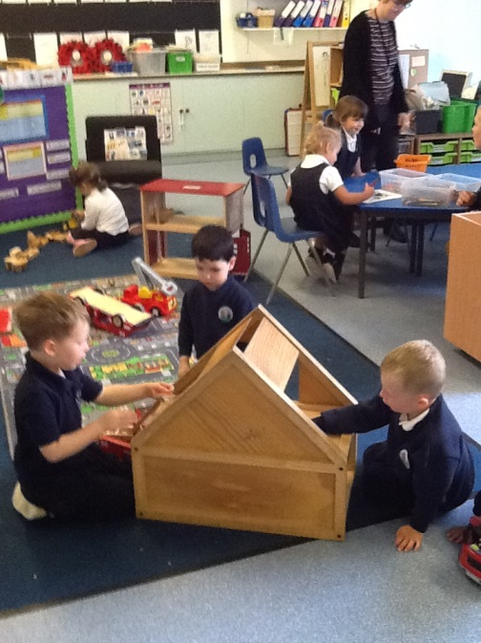
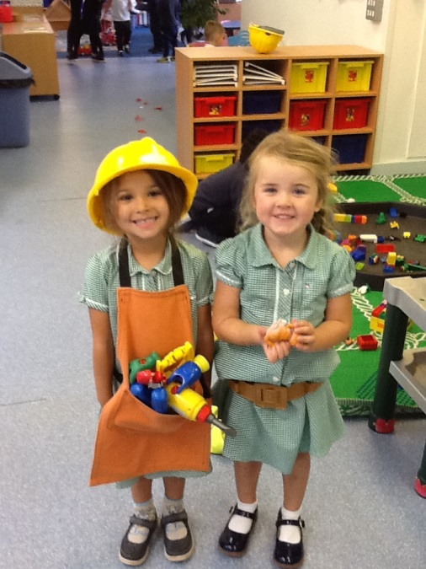
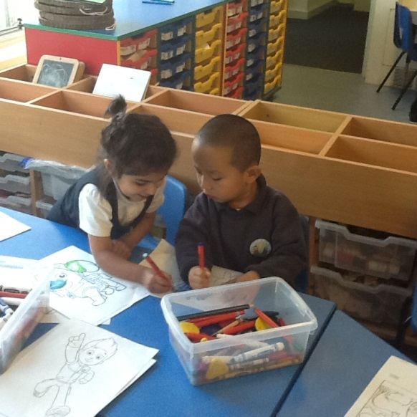
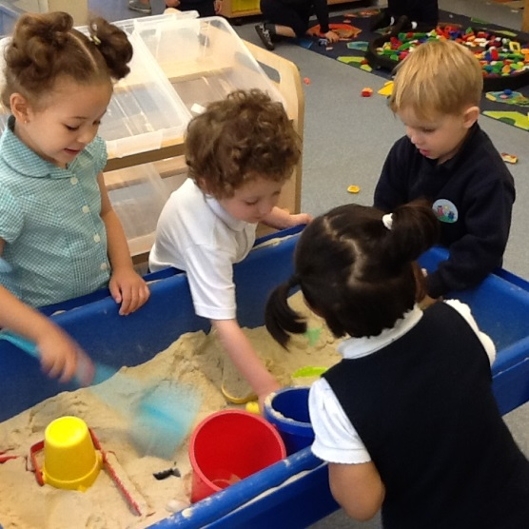
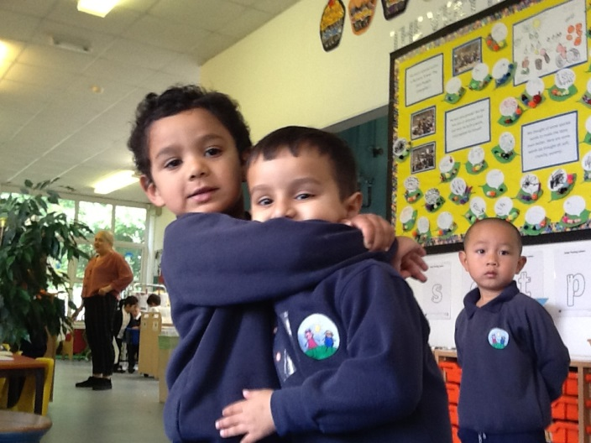
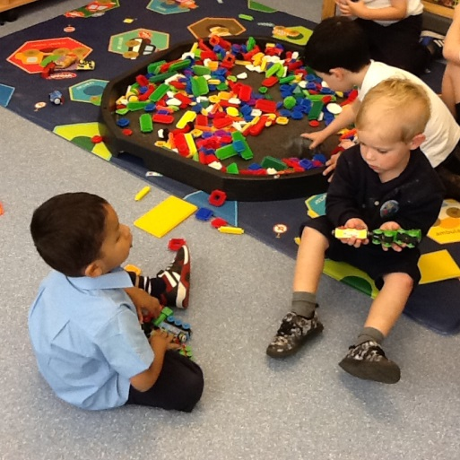
Friendship, caring and sharing

Slide 13
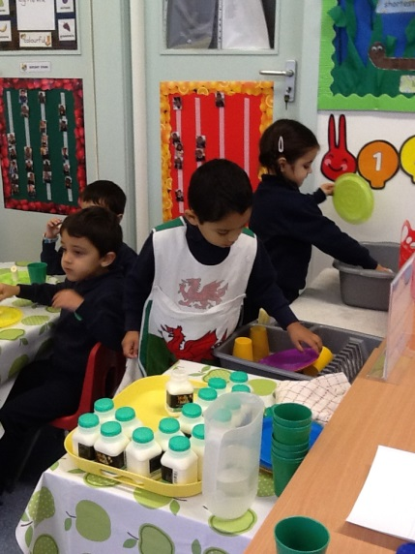
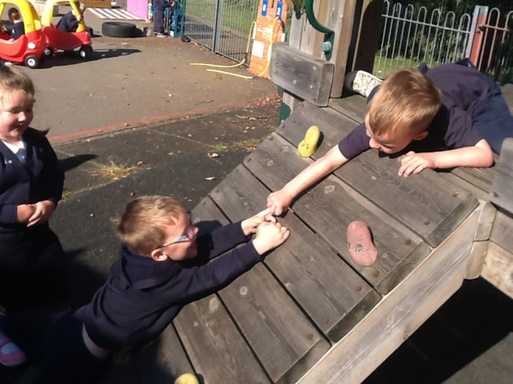
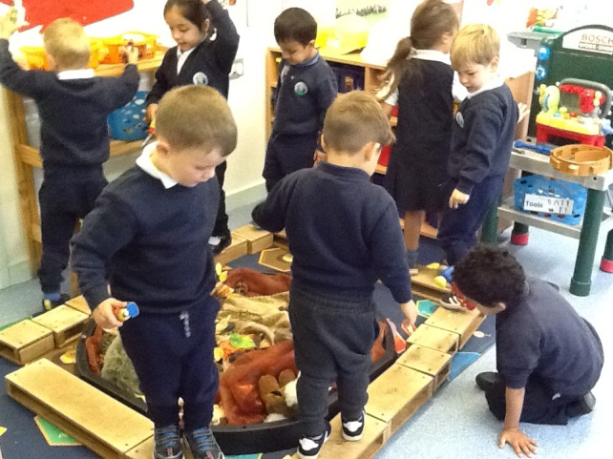
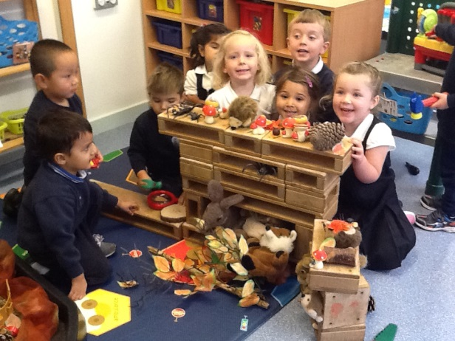
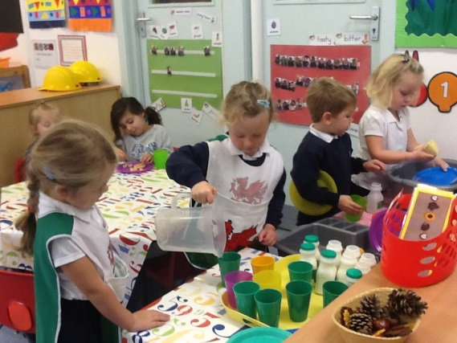
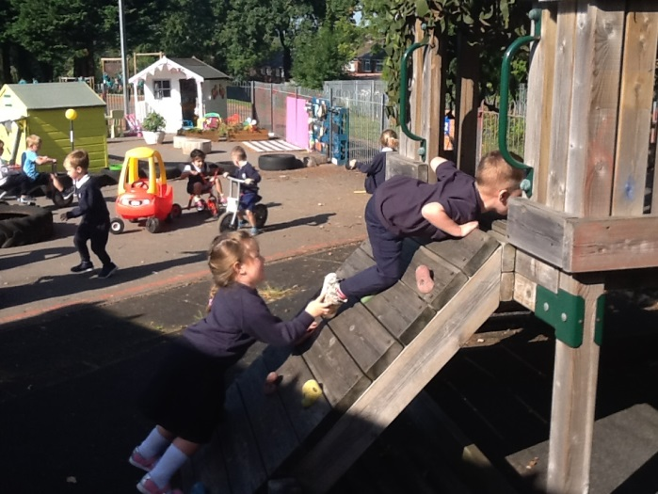
Cooperation & Independence

Slide 14
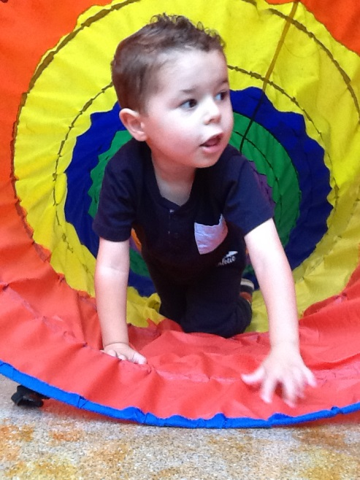
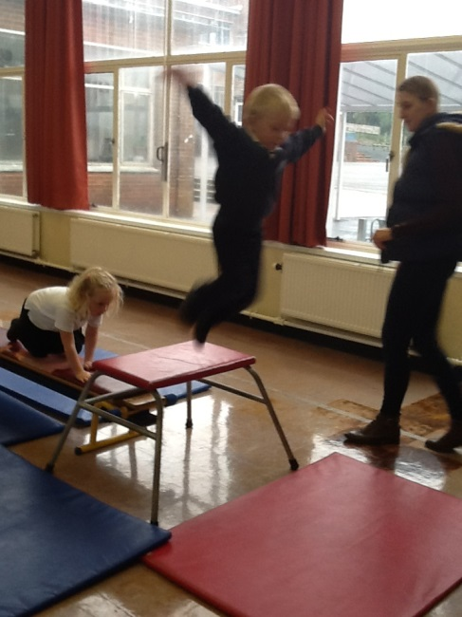
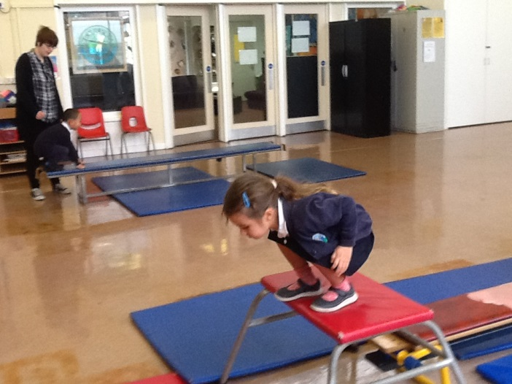
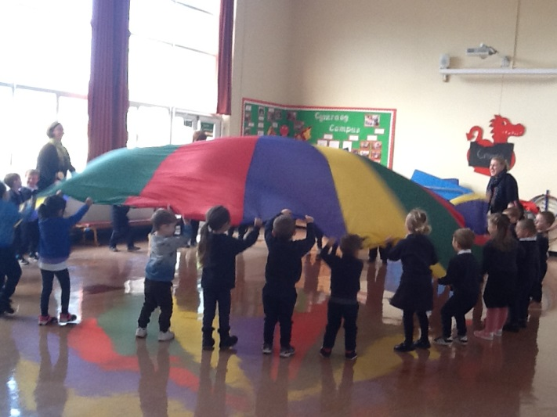
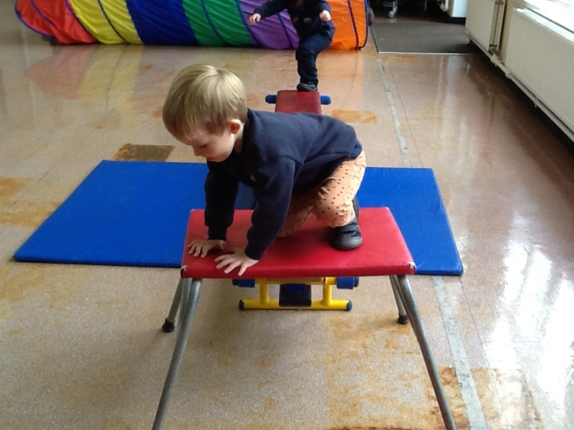
Physical Development

Slide 15
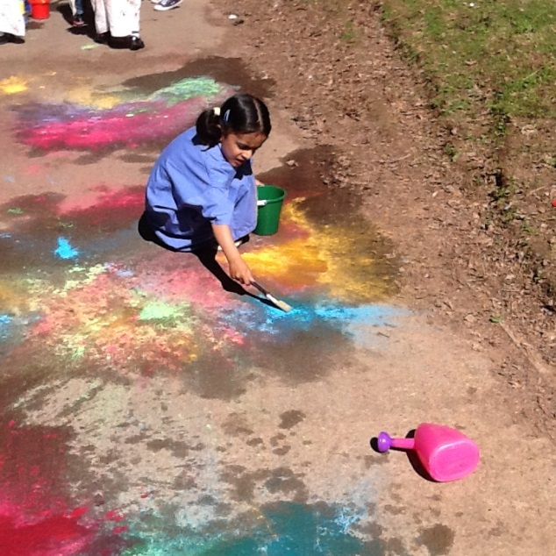
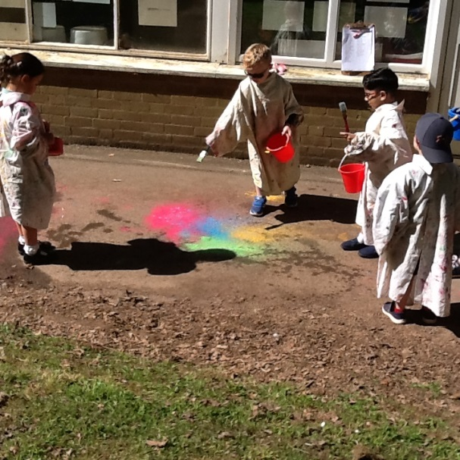
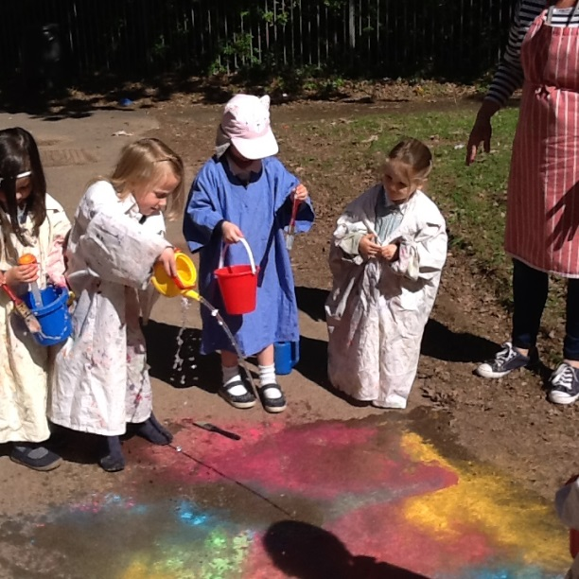
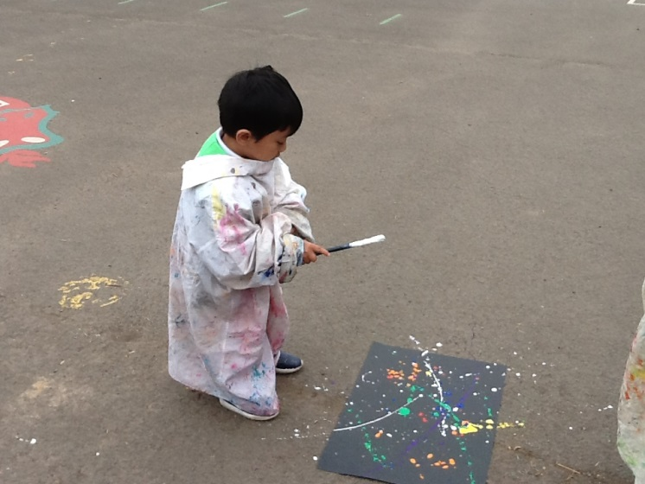
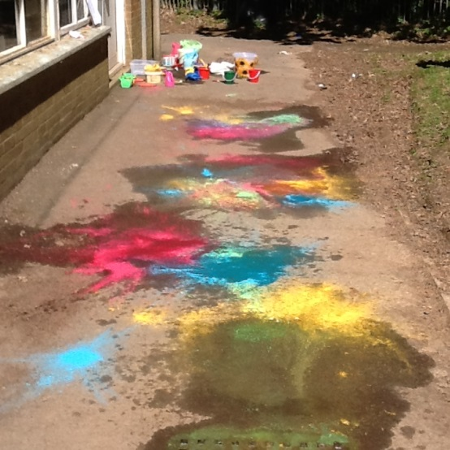
How many colours in a rainbow?

Slide 16
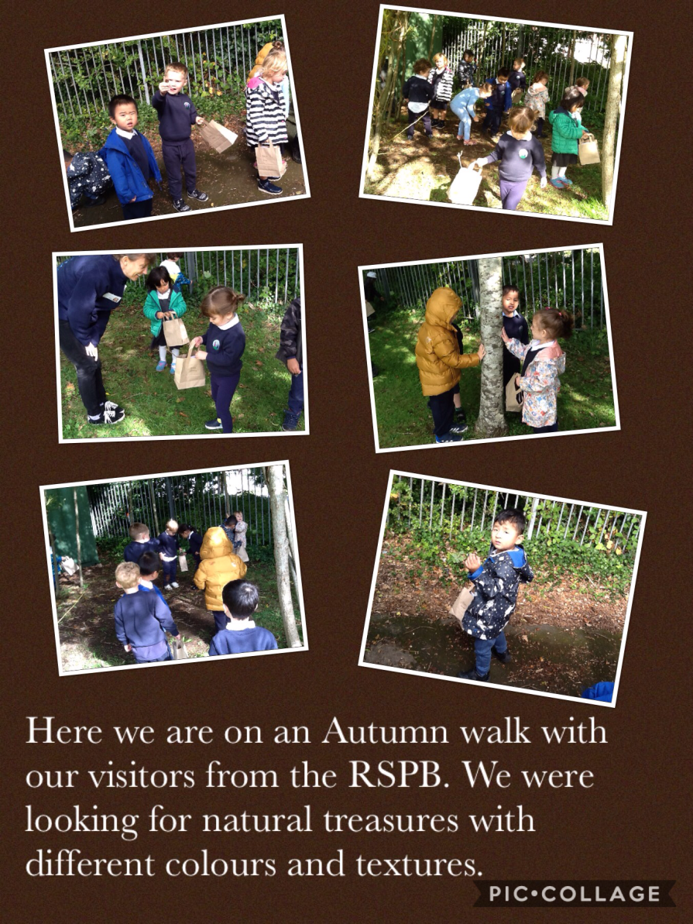
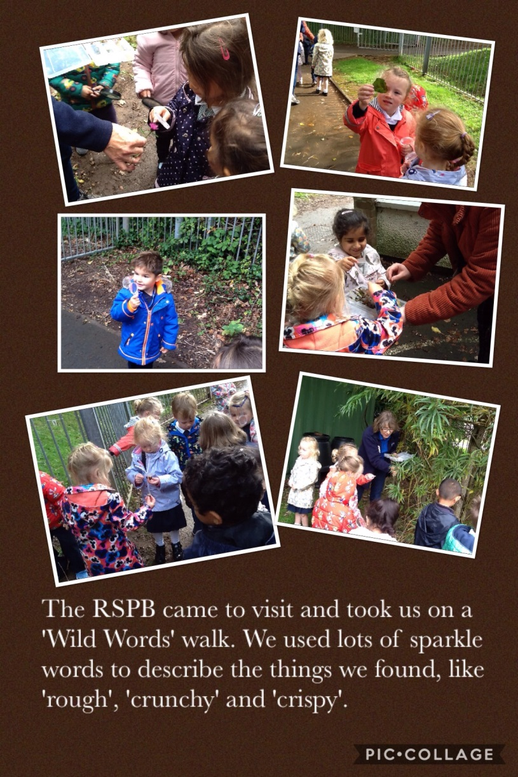
Exploring Autumn

Slide 17
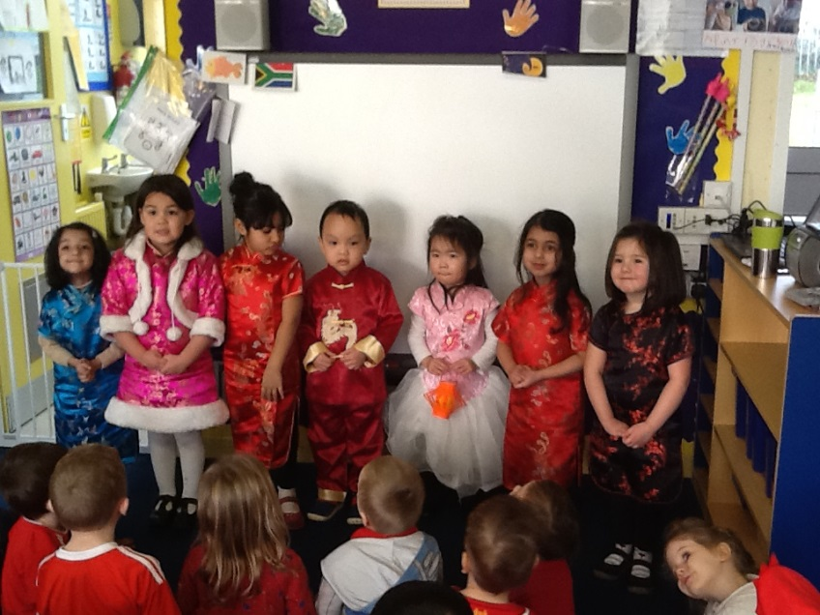
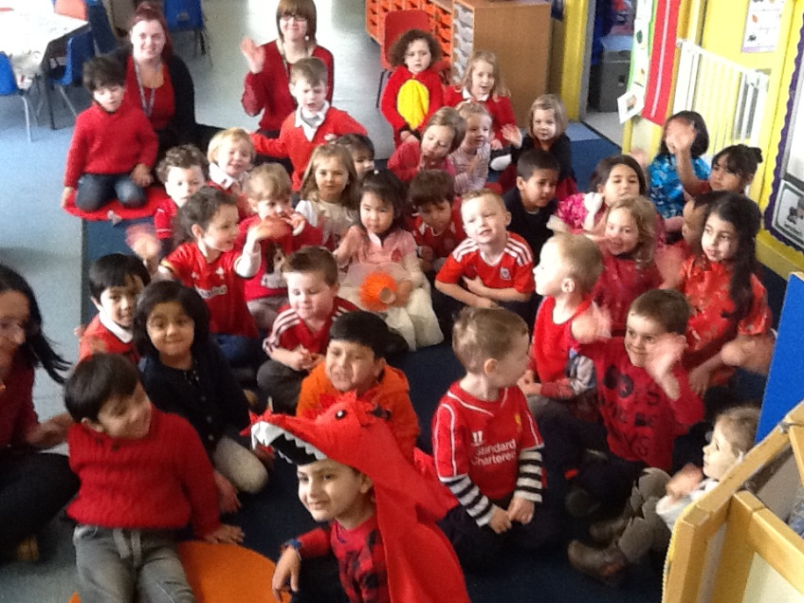
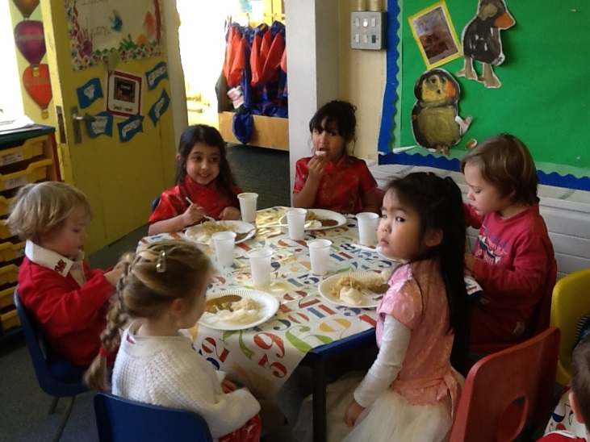
Chinese New Year

Slide 18
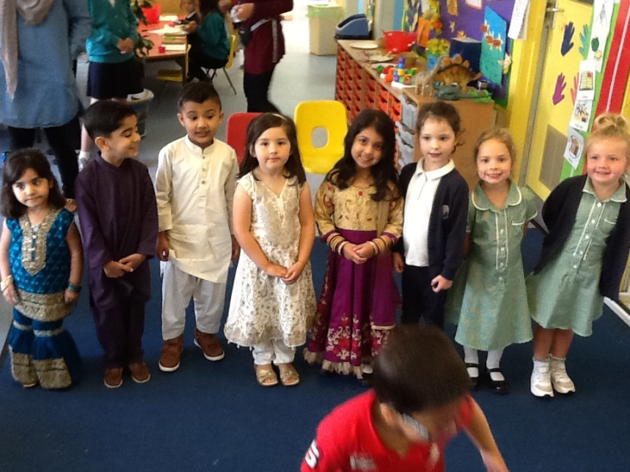
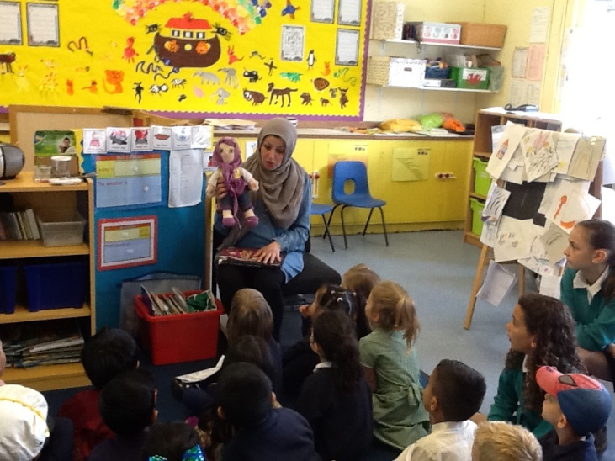
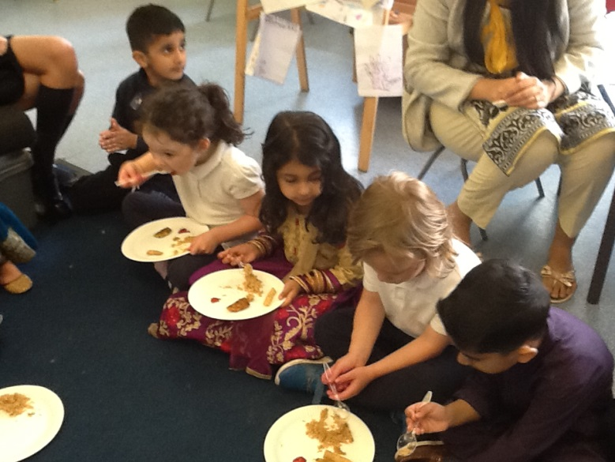
Eid

