Slide 1


I’m Going to Reception!

Slide 2

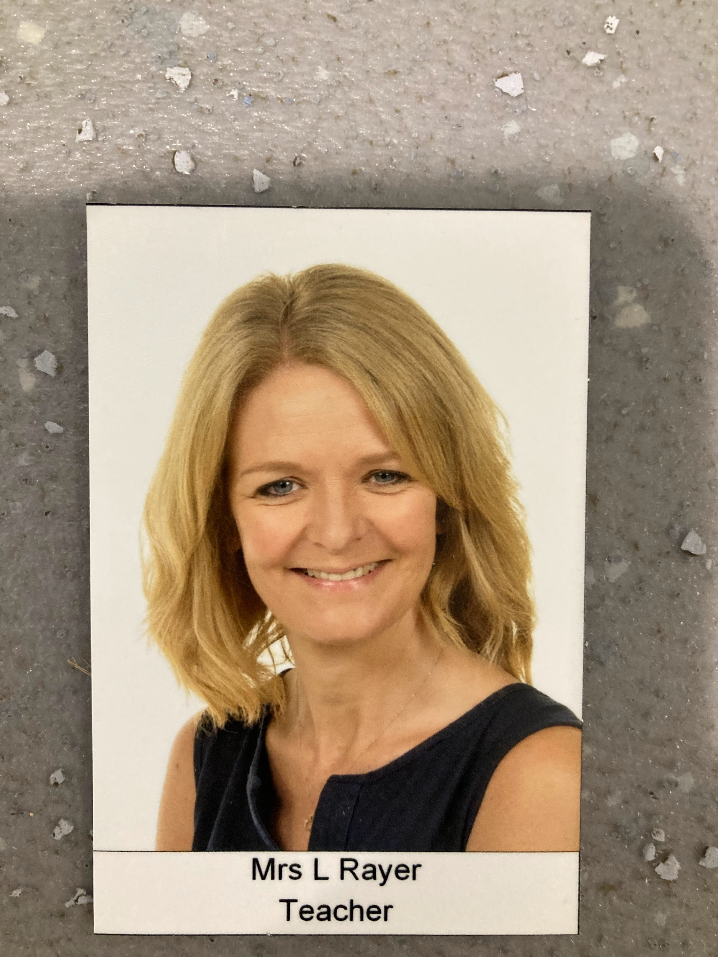
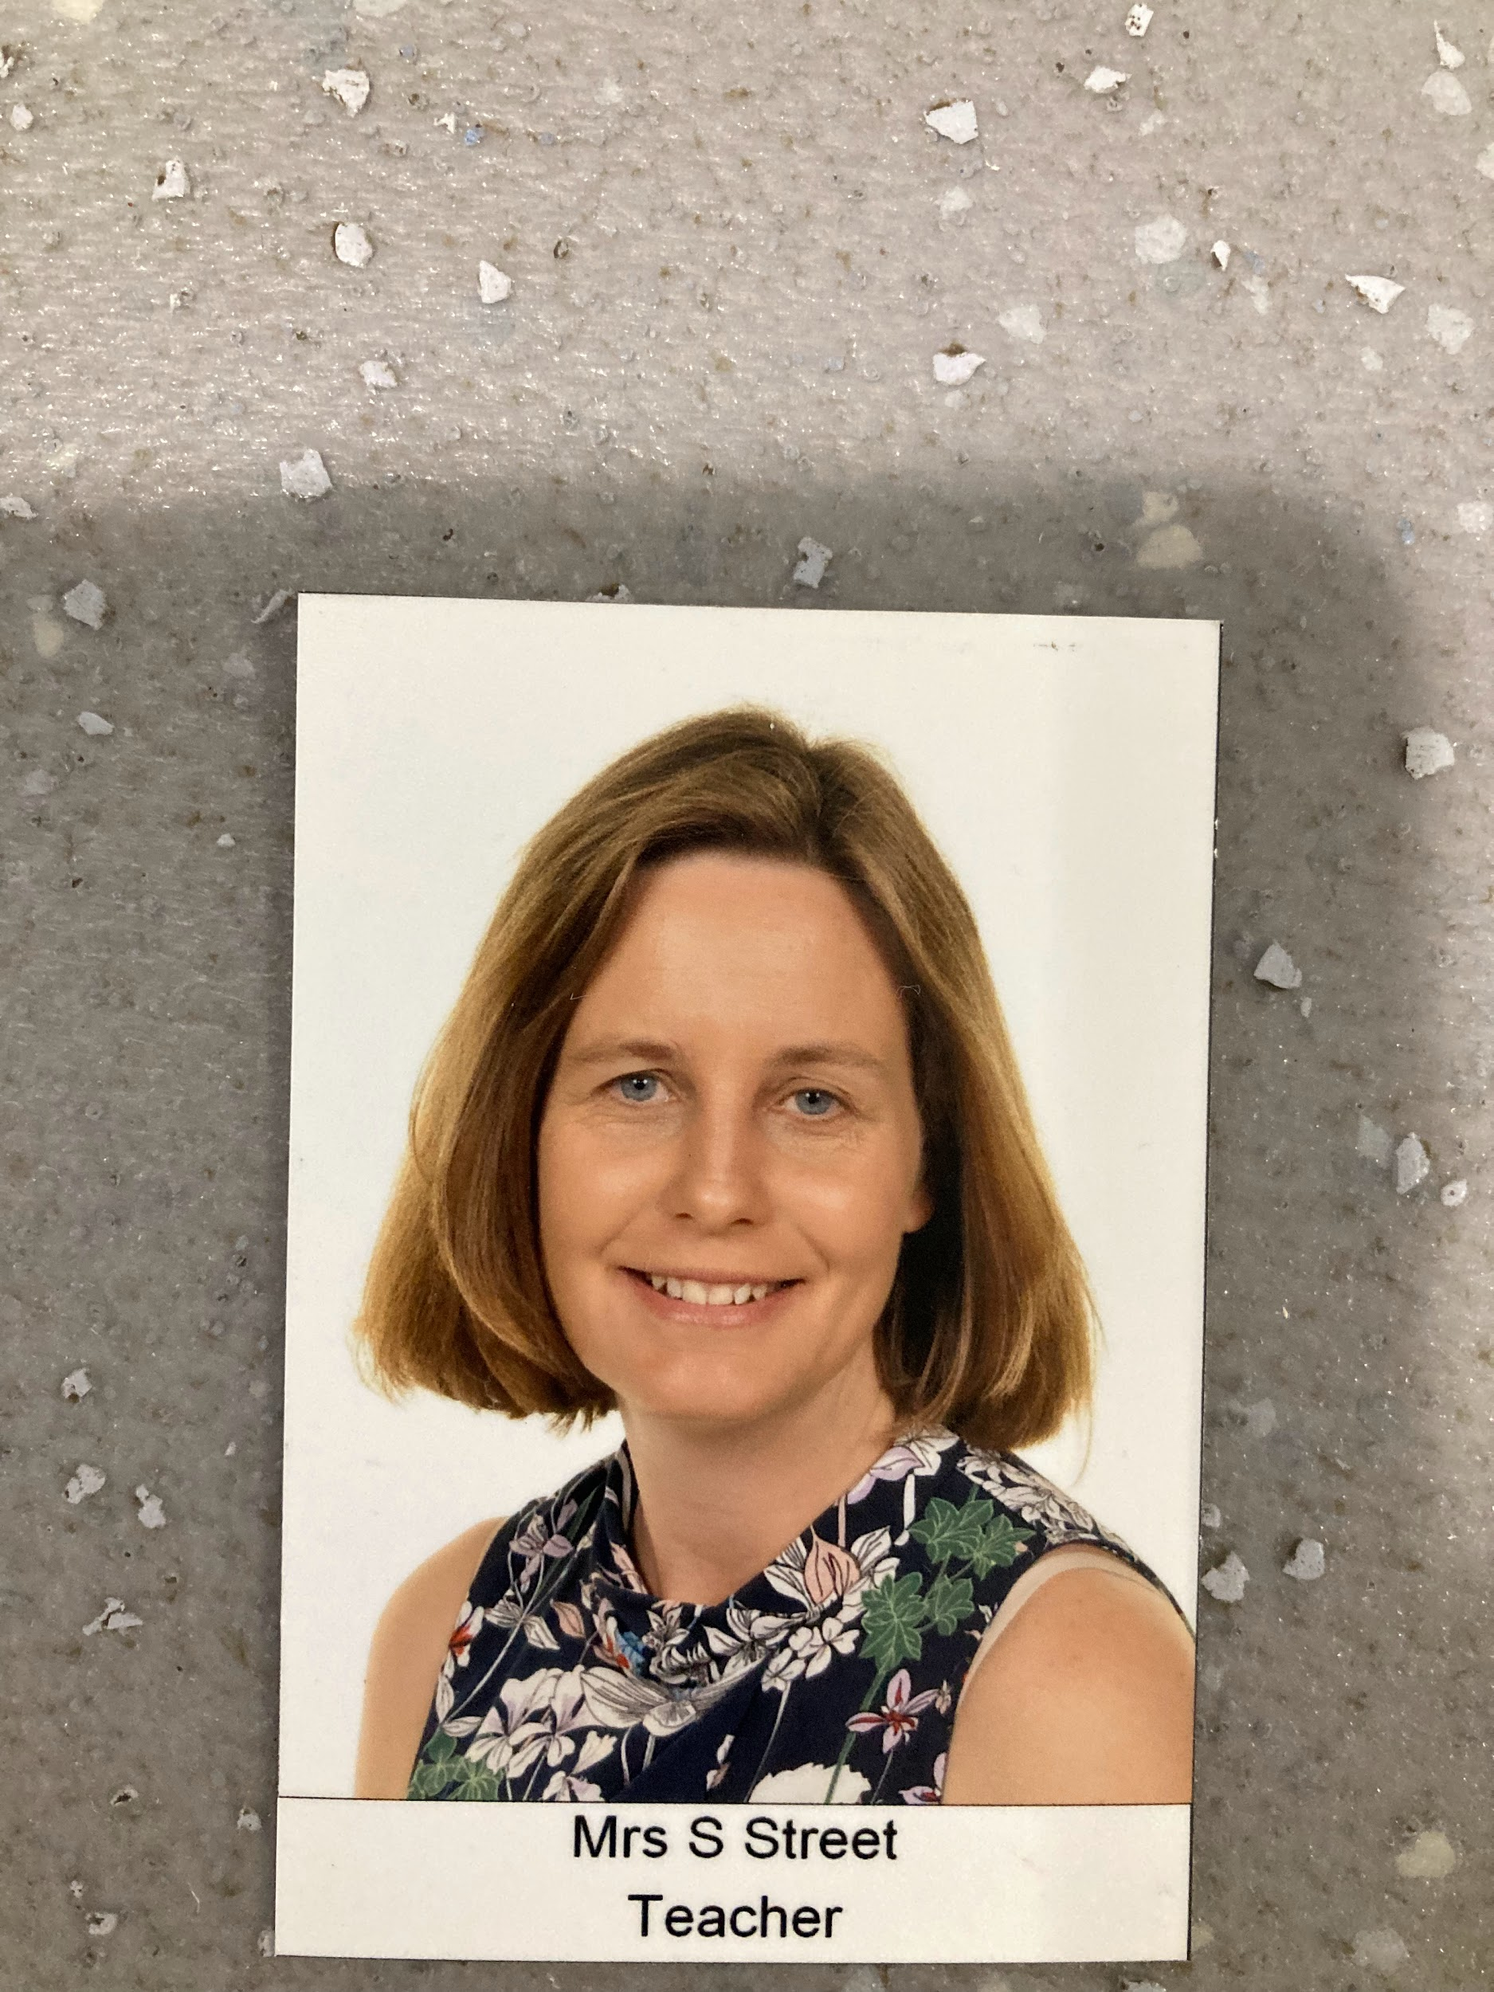
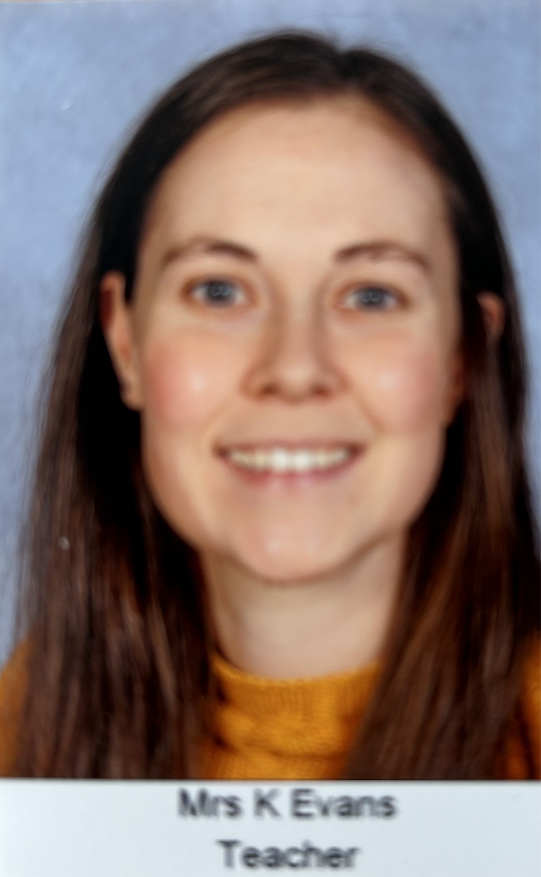
Who will help me in Reception?
Do not worry! There are lots of kind people who will help you and your friends when you move from Nursery to Reception class:
Mrs Rayer RS
Mrs Street RS
Mrs Evans RE
The Reception team are really looking forward to meeting you and helping you learn.The teachers in RS are called Mrs Rayer (Mon, Tues, Wed) and Mrs Street (Thurs, Fri).
The teachers in RE will be Mrs Evans (Tues, Wed, Thurs, Fri) and Mrs Street (Mon).

Slide 3
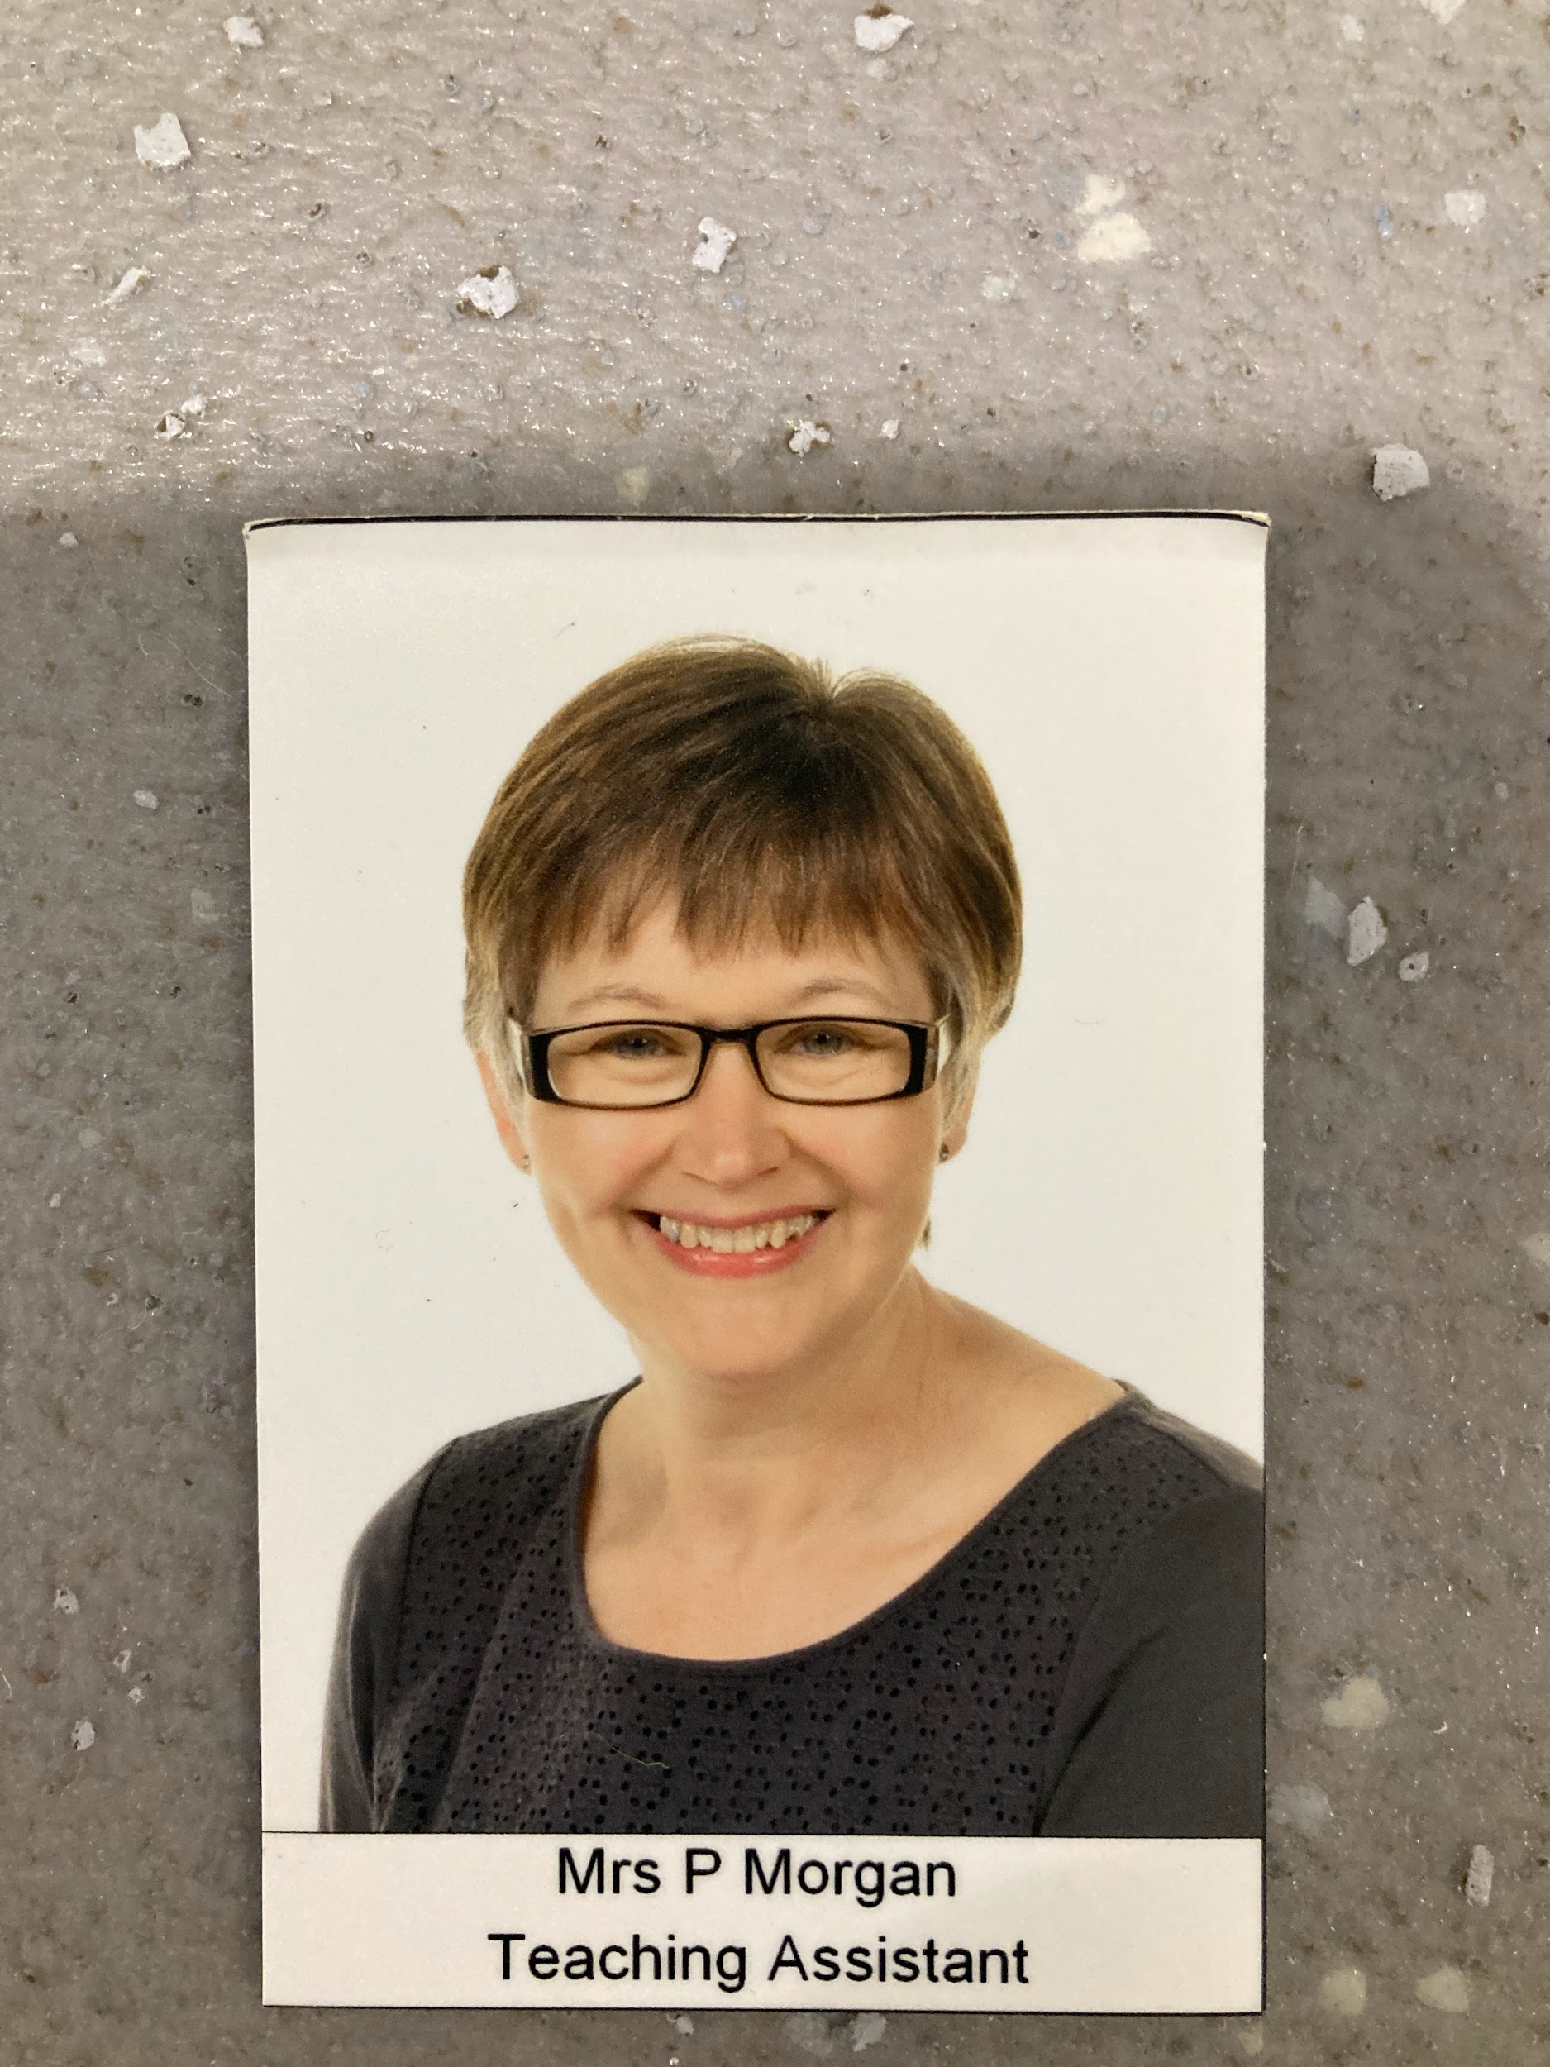
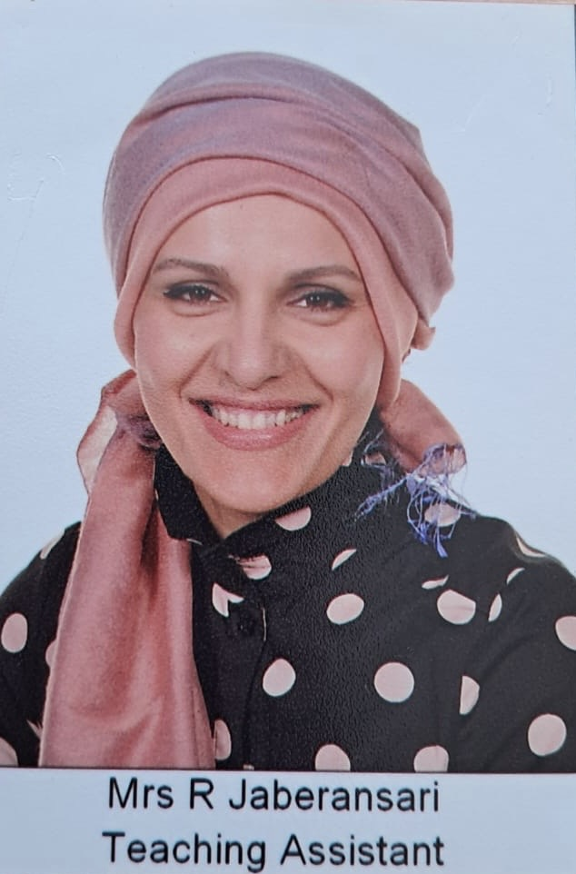
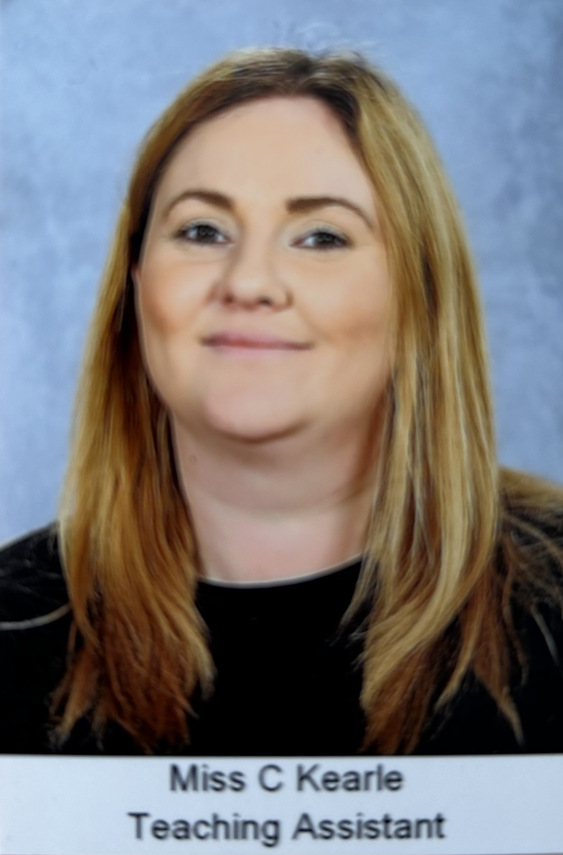
Who will help me in Reception?
Do not worry! There are lots of kind people who will help you and your friends when you move from Nursery to Reception class:
Mrs Morgan
Mrs Jaberansari
Miss Kearle
The teaching assistants in Reception are called Mrs Morgan (Mon,Tues,Wed) Mrs Jaberansari (Tues,Thurs, Fri) and Miss Kearle (Mon - Fri)

Slide 4

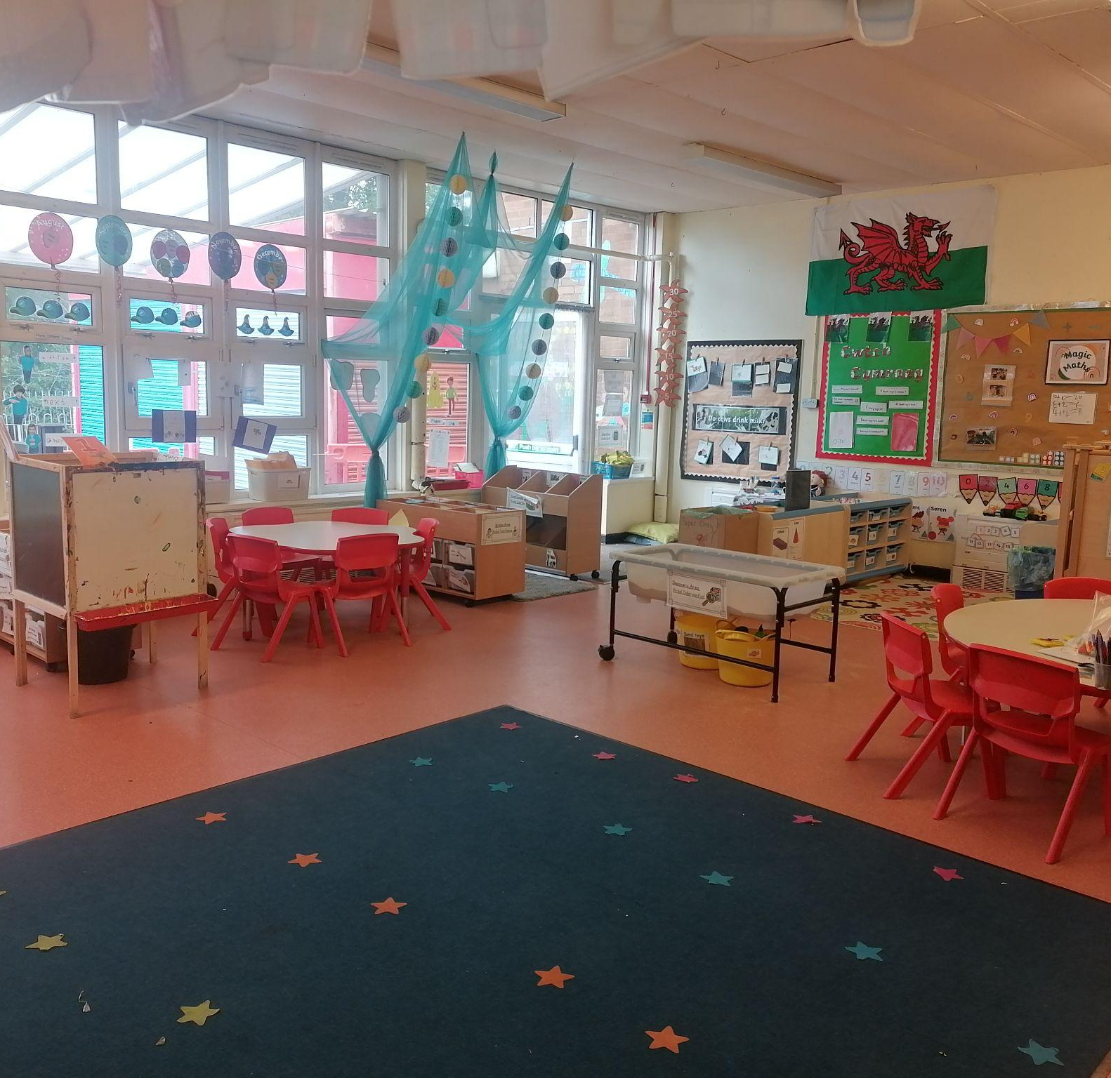
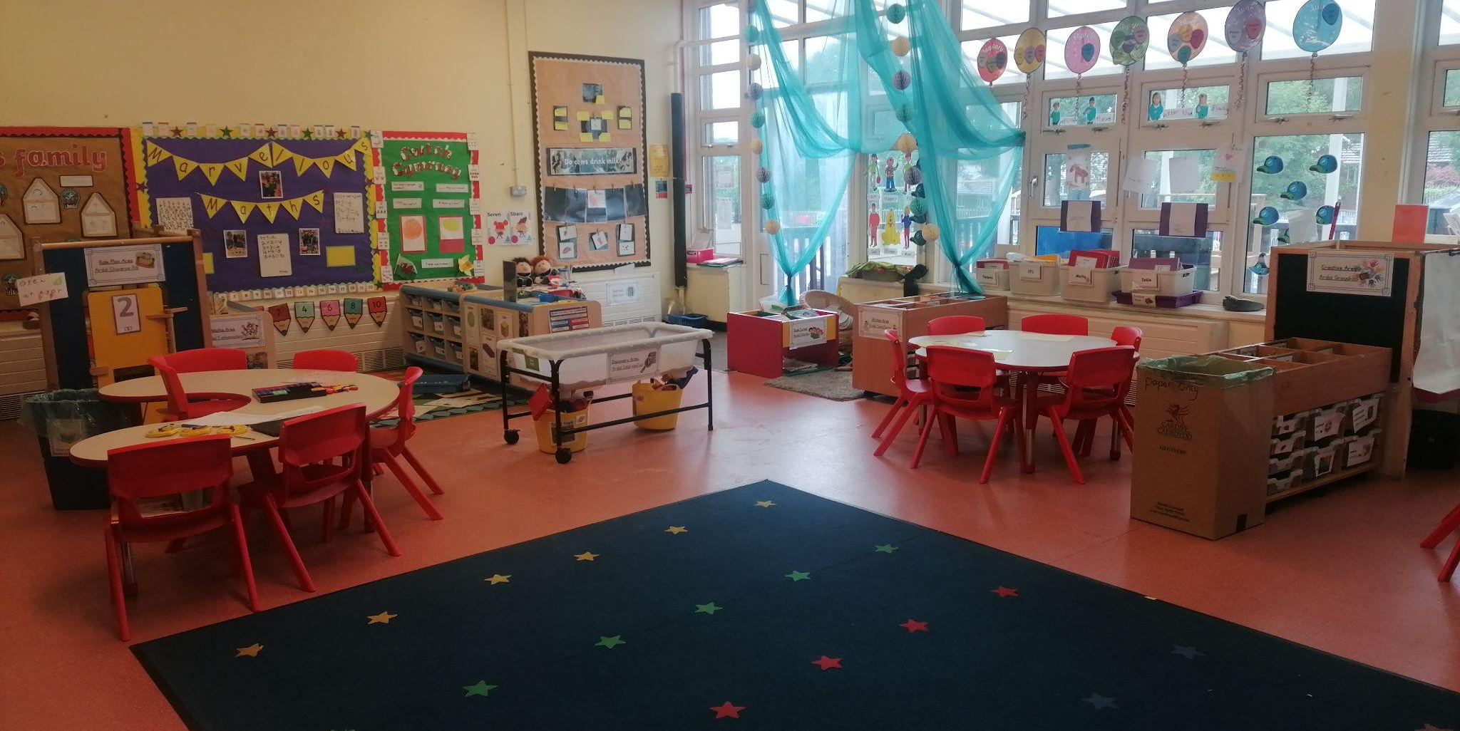
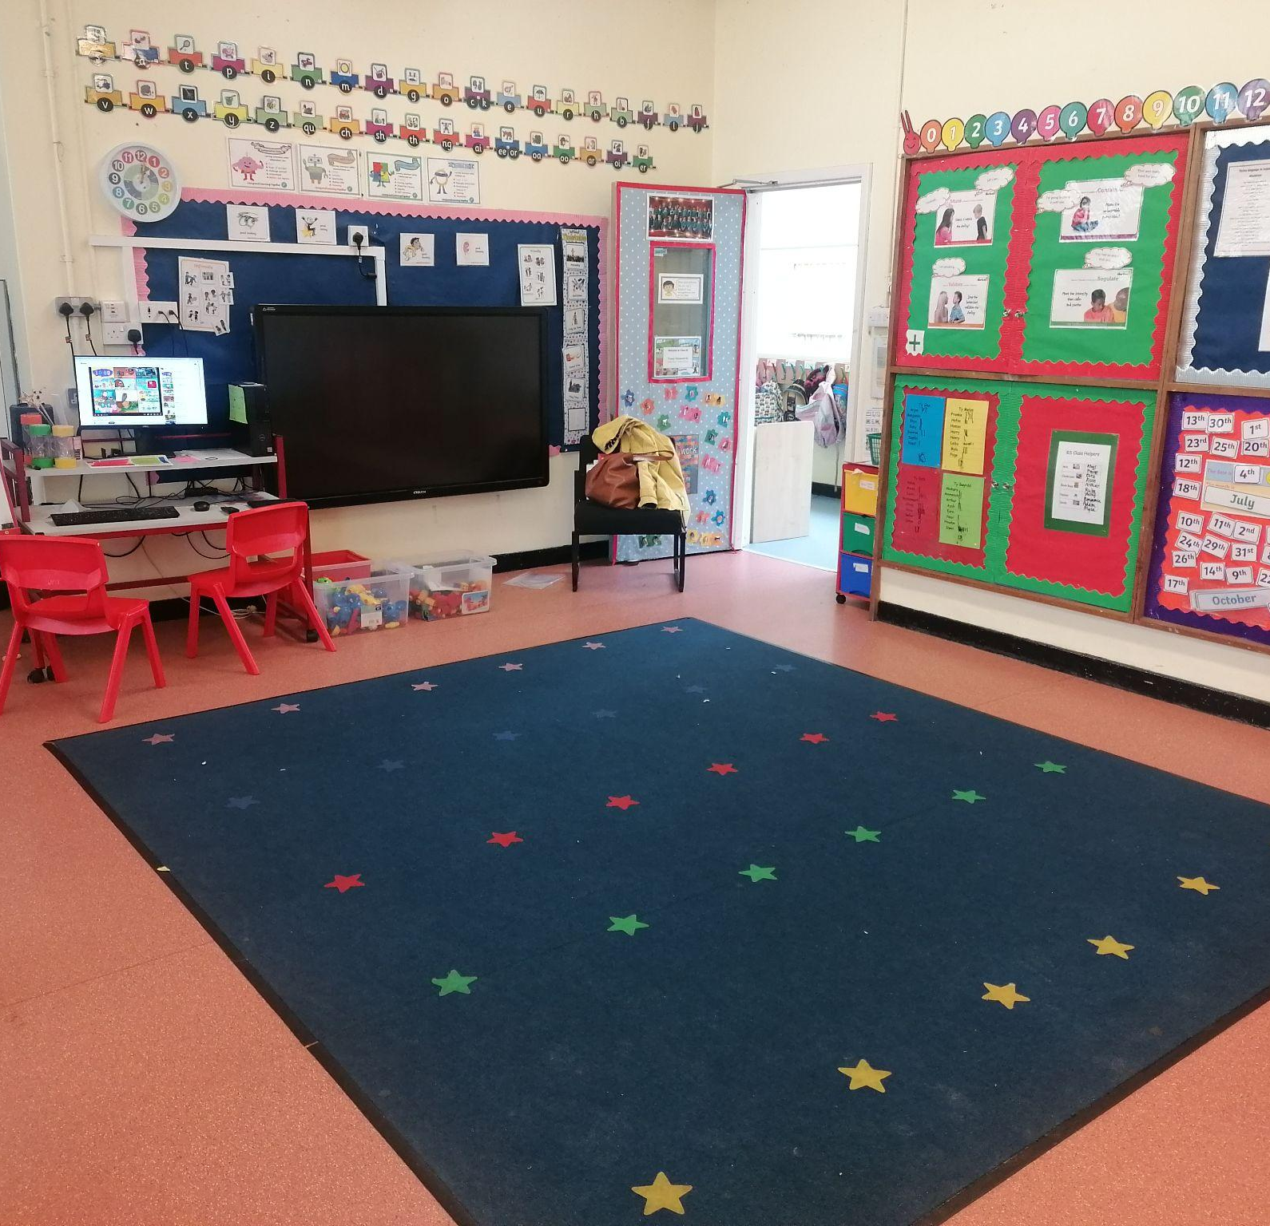
Let’s have a look around your new classrooms

Slide 5

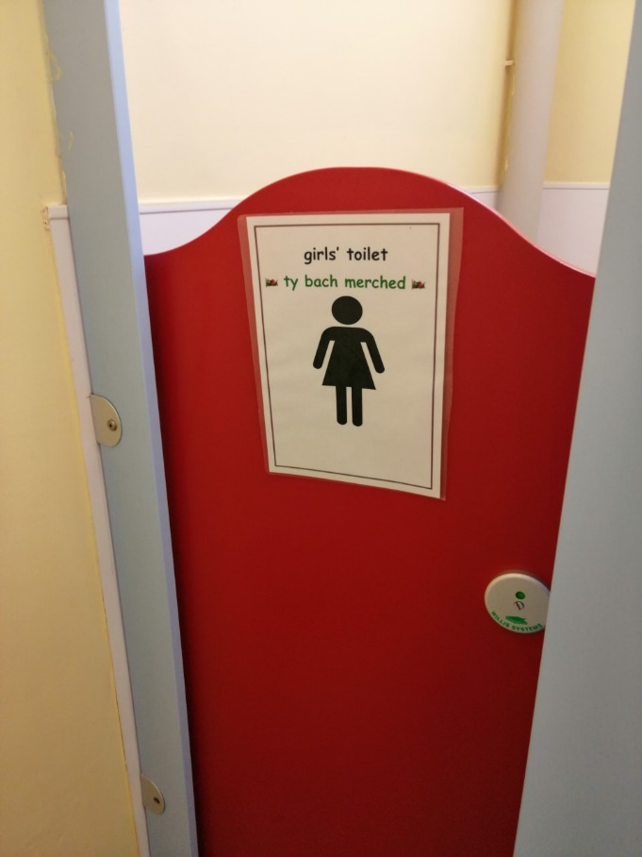
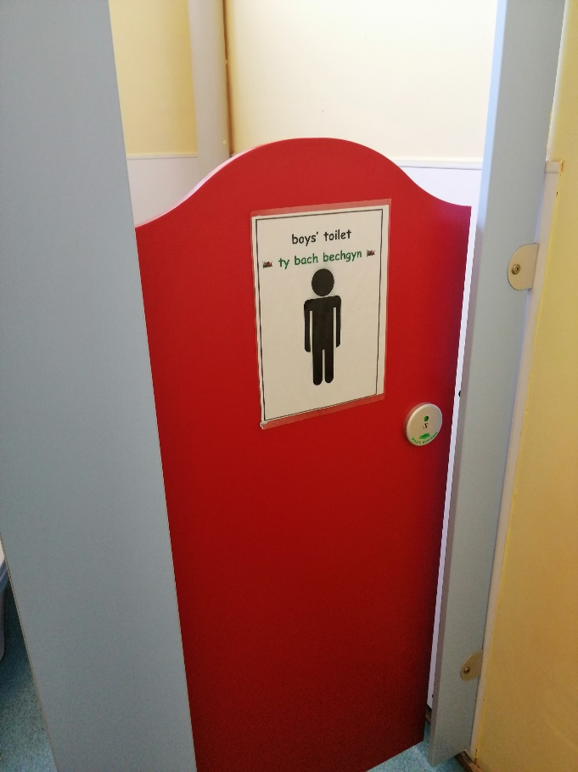
Where are the toilets?
Do not worry, the toilets are in your classroom and all you need to do is look for these signs
But always ask if you need help!

Slide 6

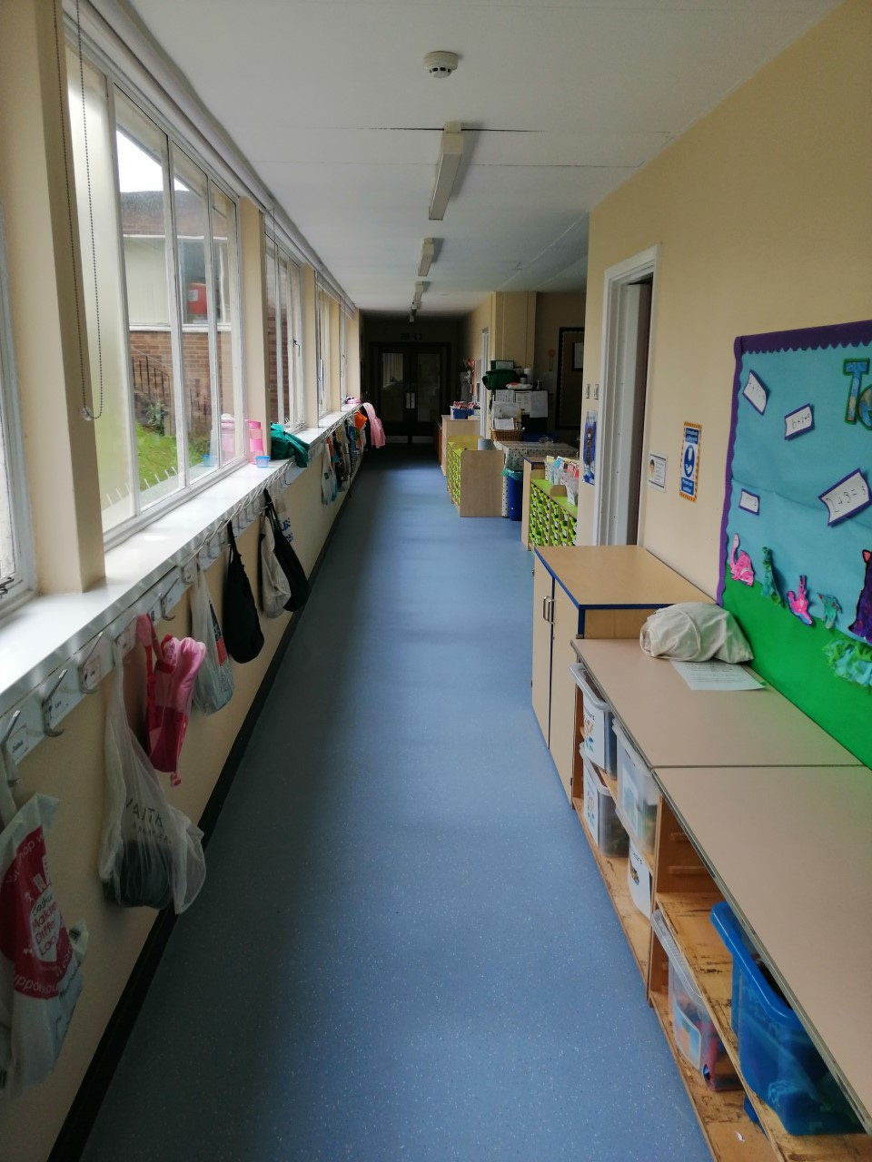
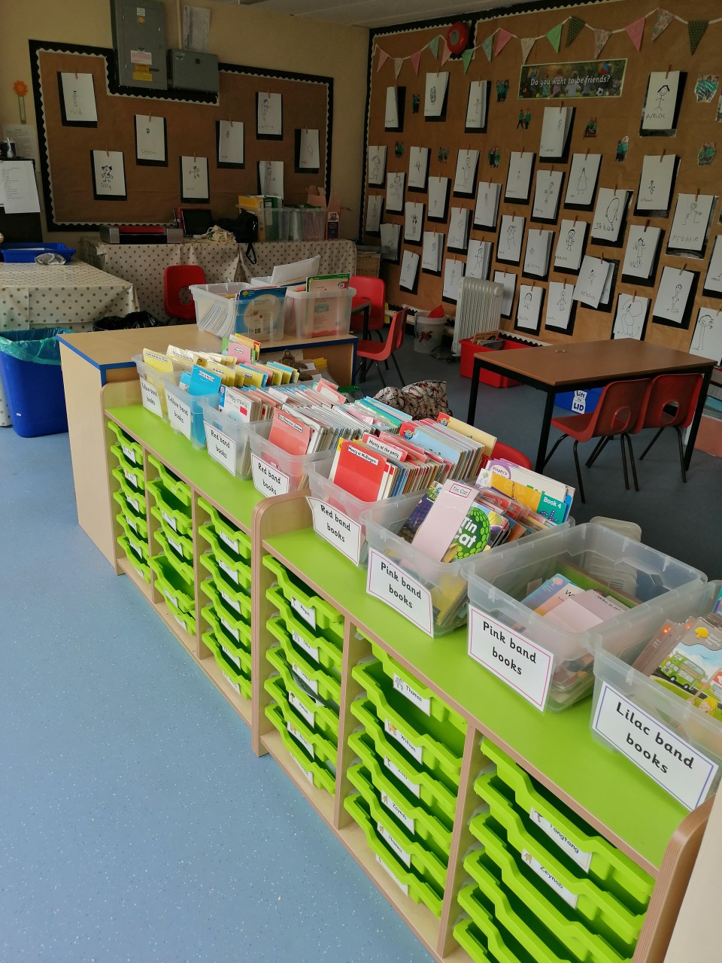
Outside the classroom you will have a drawer for your work and a peg for your coats and bags

Slide 7
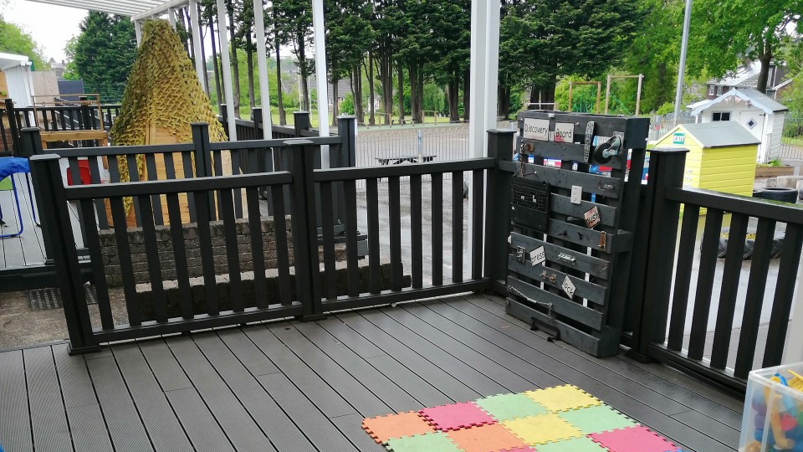
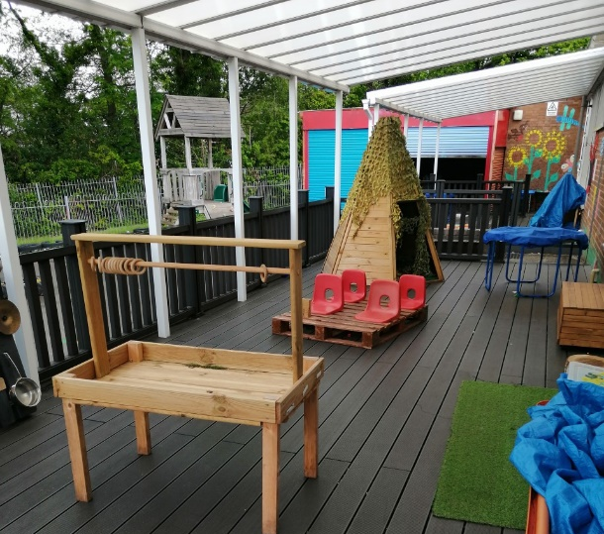
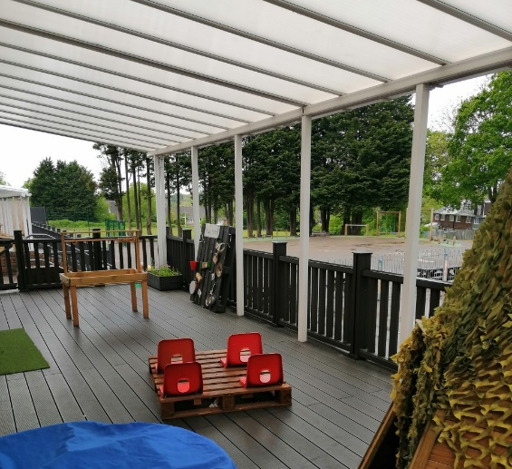
We also learn outside on the decking

Slide 8
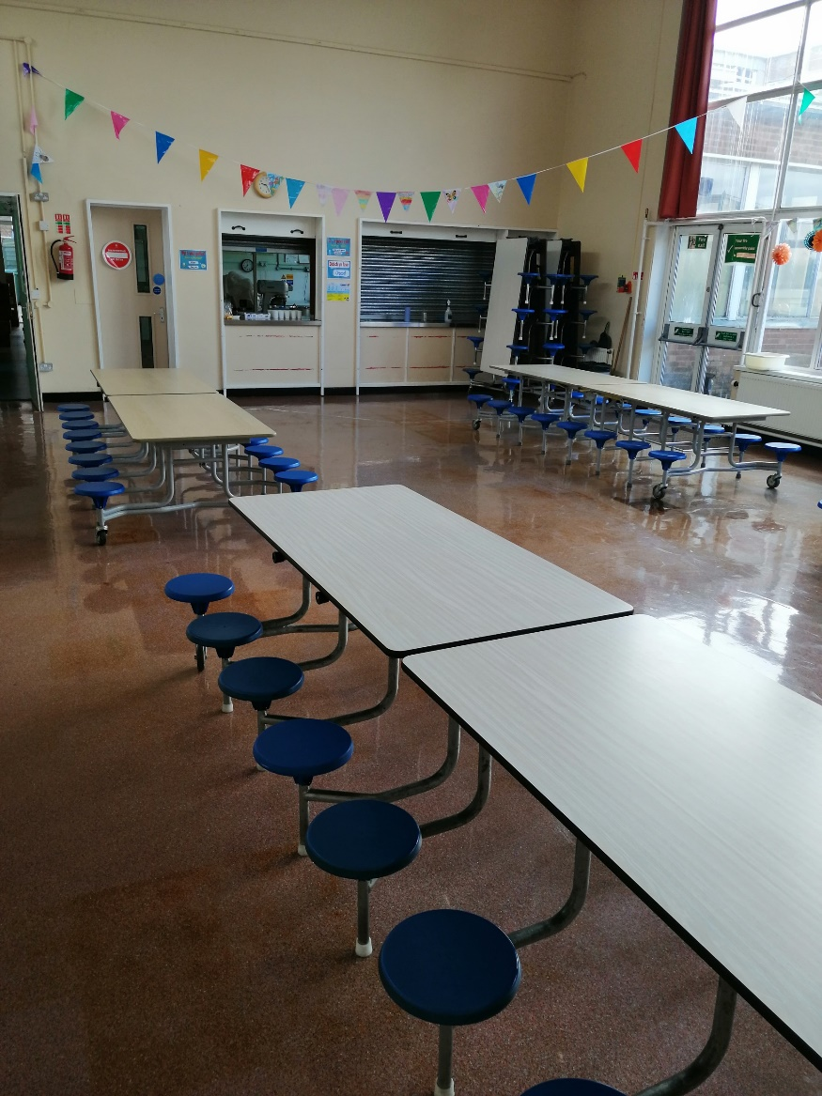
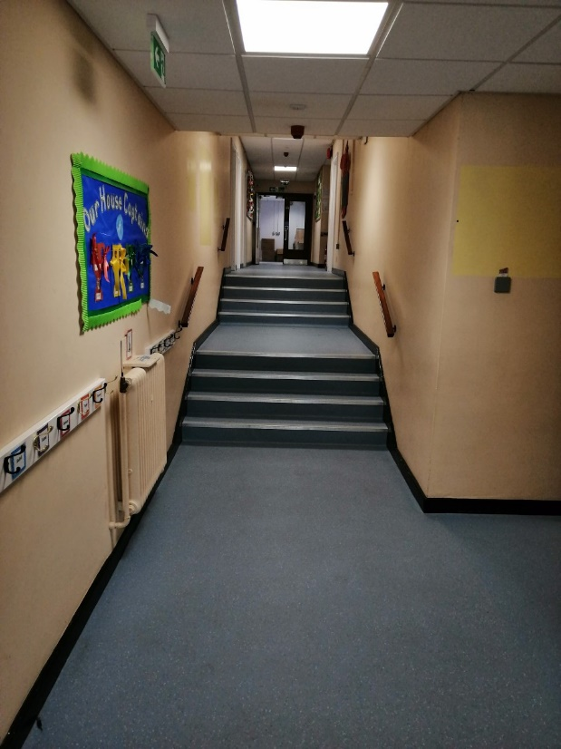
We eat our lunch in the hall!
We get to the hall using this corridor

Slide 9
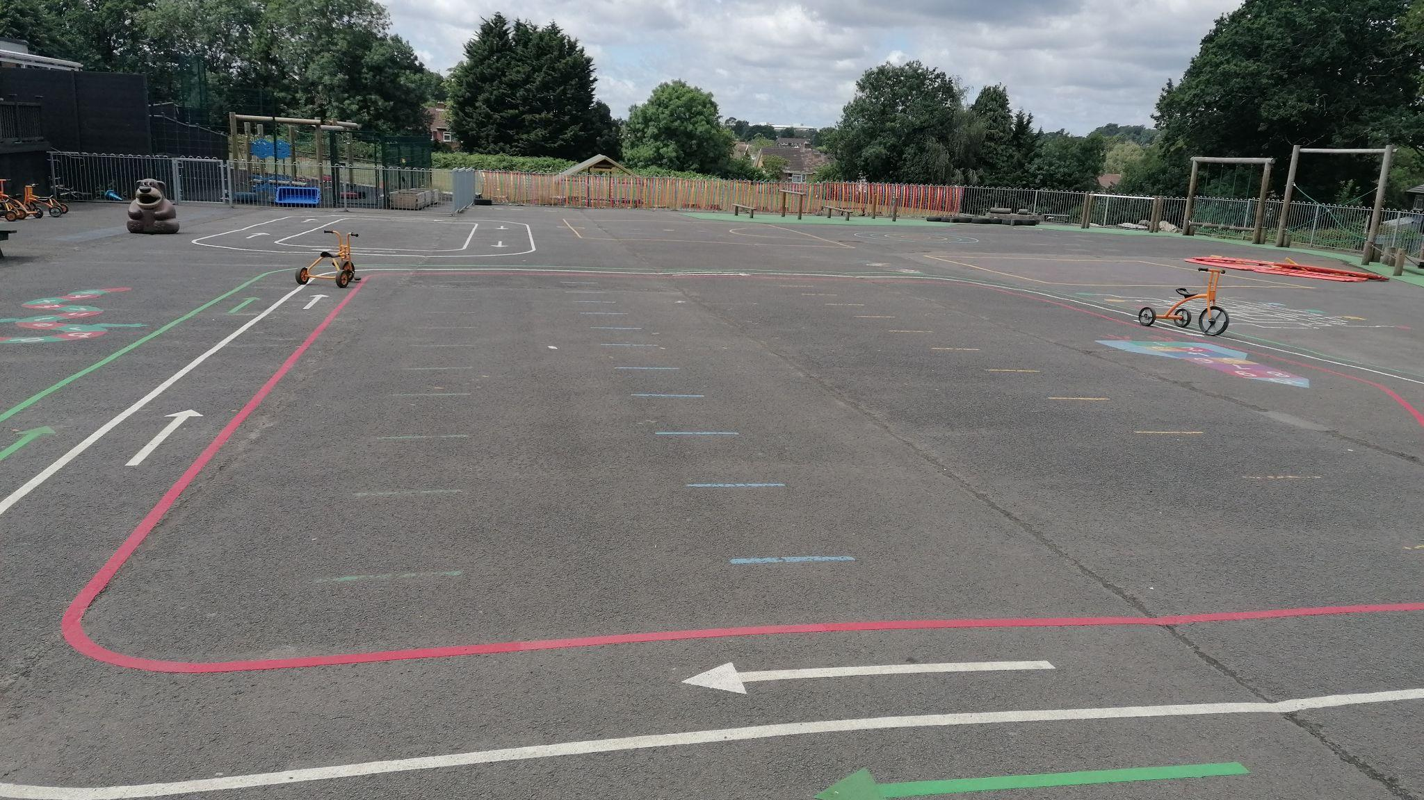
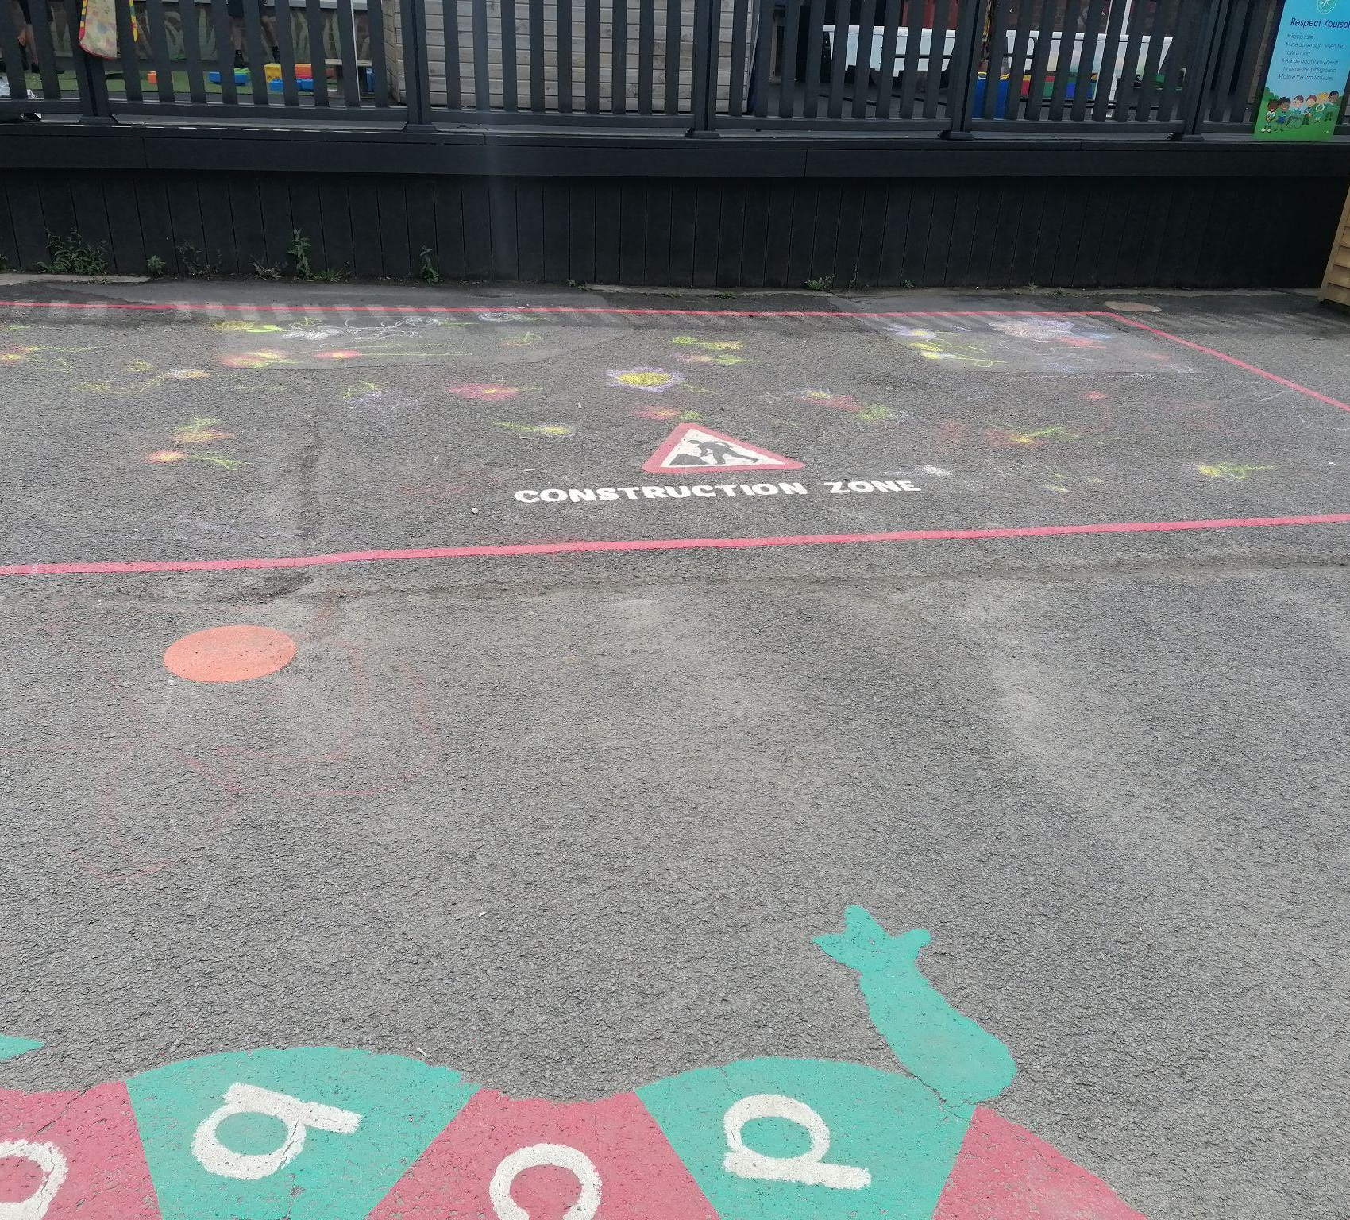
And we play with all our friends from Reception on the playground

Slide 10
You will have a great time in Reception
And always remember to ask if you need any help

