Slide 1

Curriculum Meeting
Reception
Cyfarfod Cwricwlwm Dosbarth Derbyn
Living and Learning Together in our Caring, Happy, Motivating and Engaged Community

Slide 2

Starting school
Dechrau yn yr ysgol
Partnership
Children, parents, staff
Working together
Lakeside nursery
Other nurseries

Slide 3
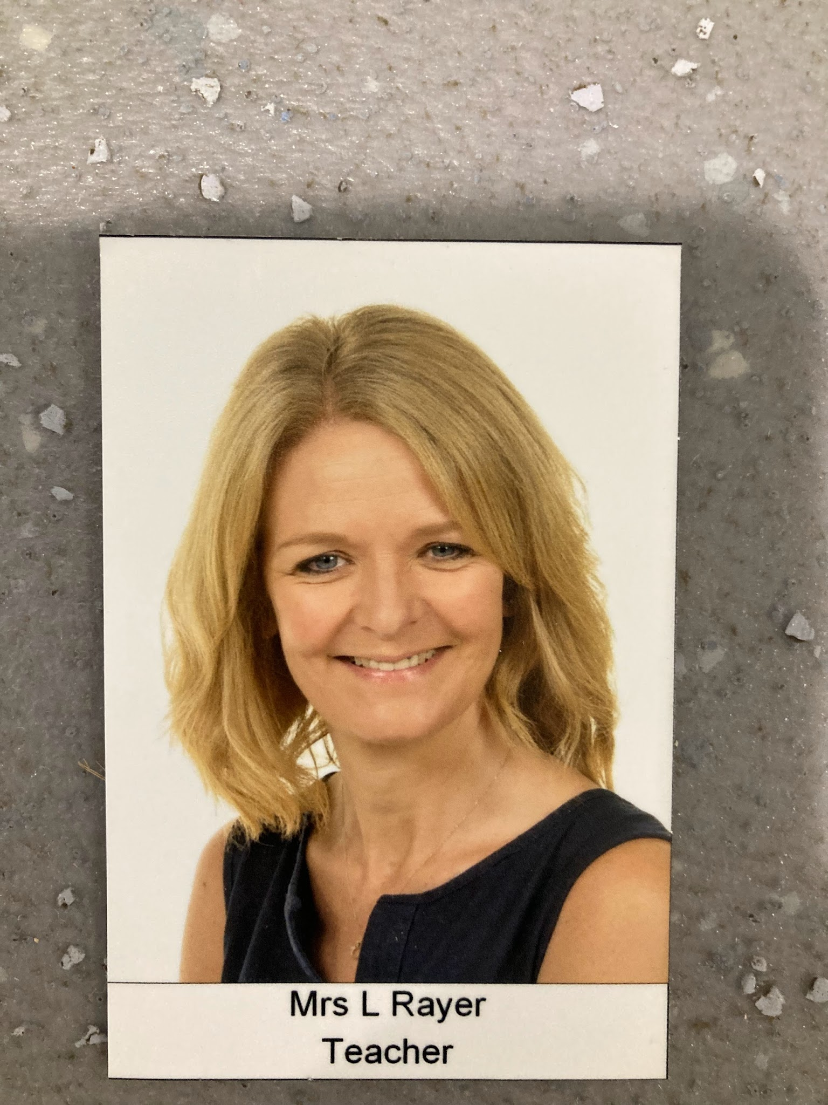
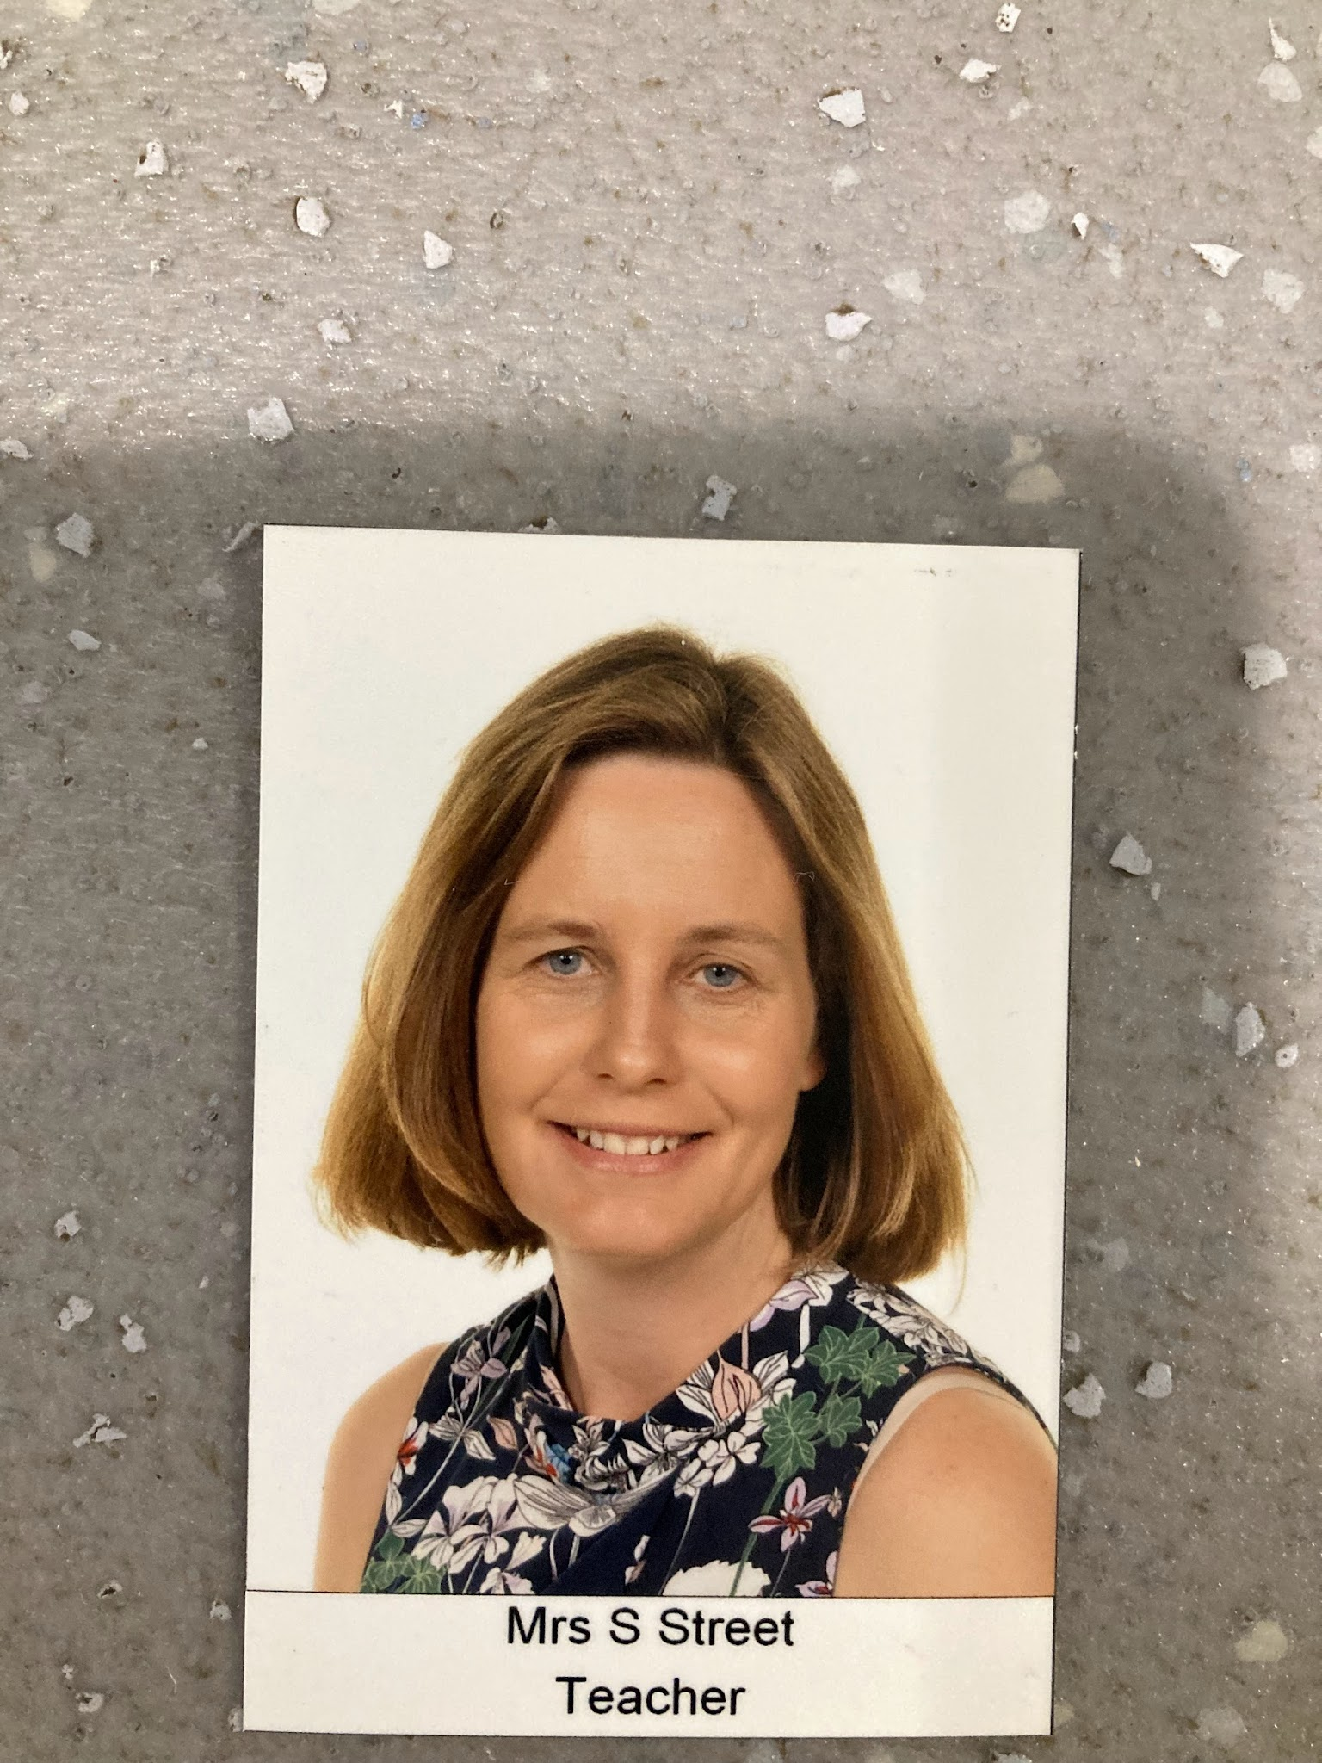
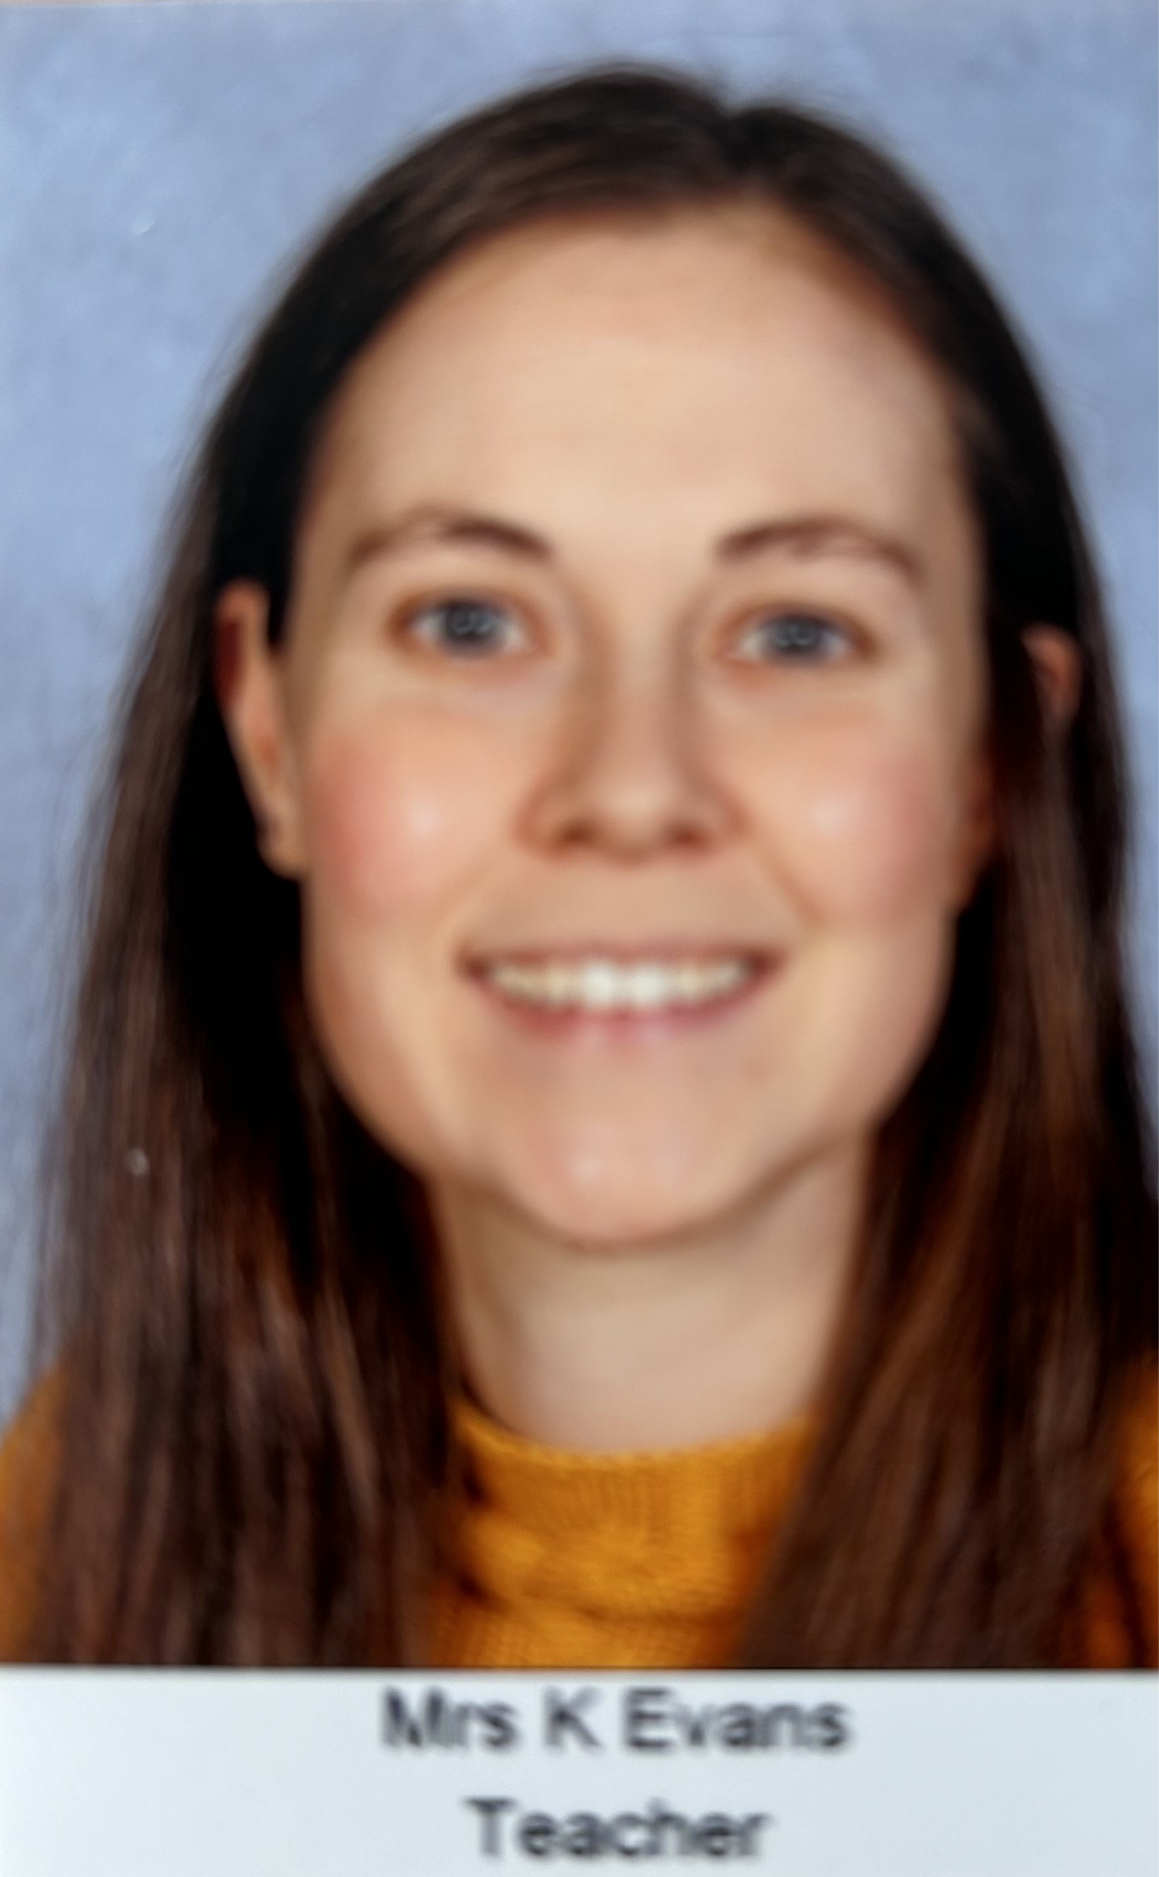
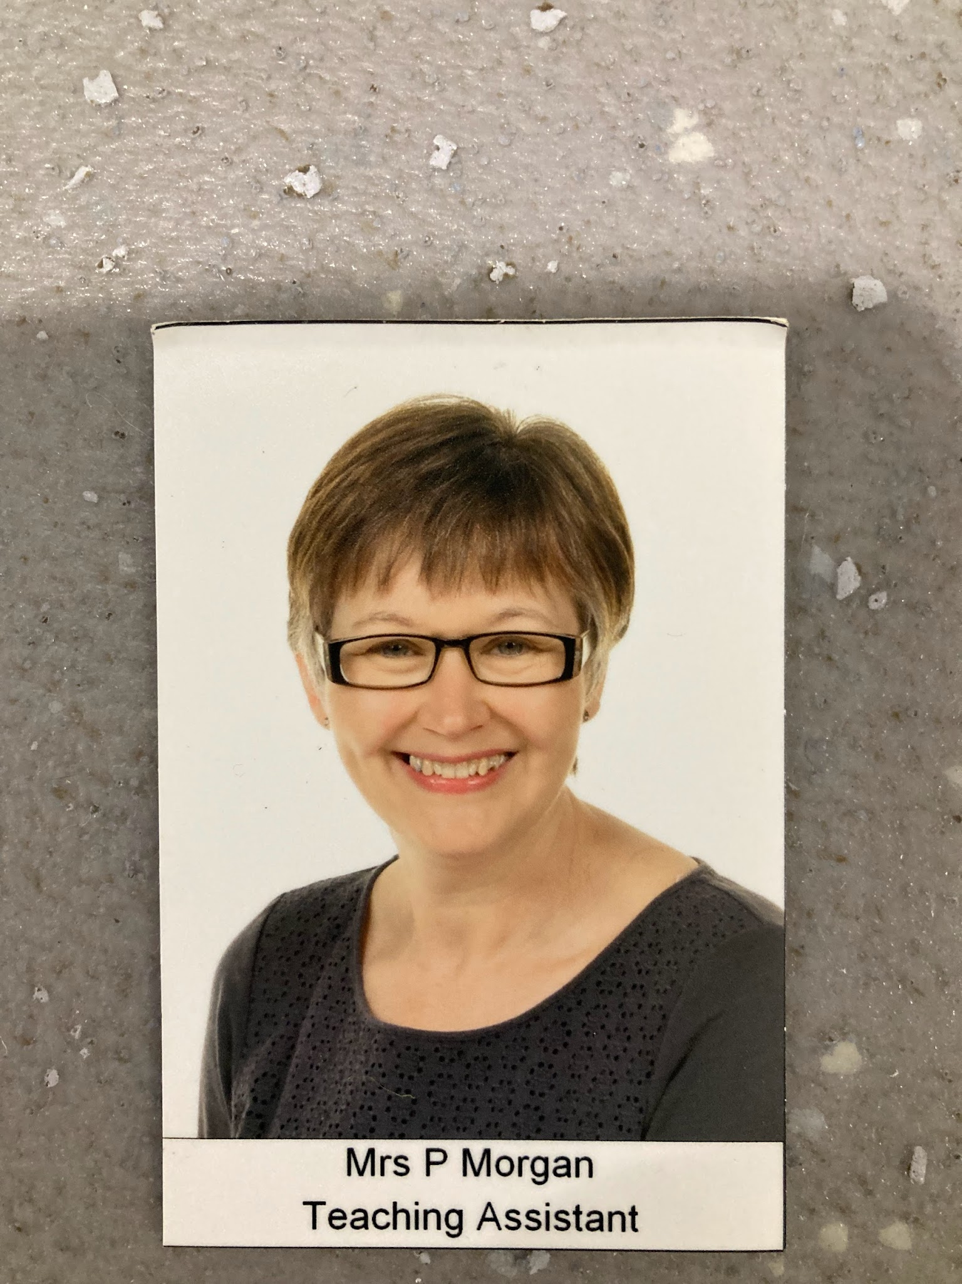
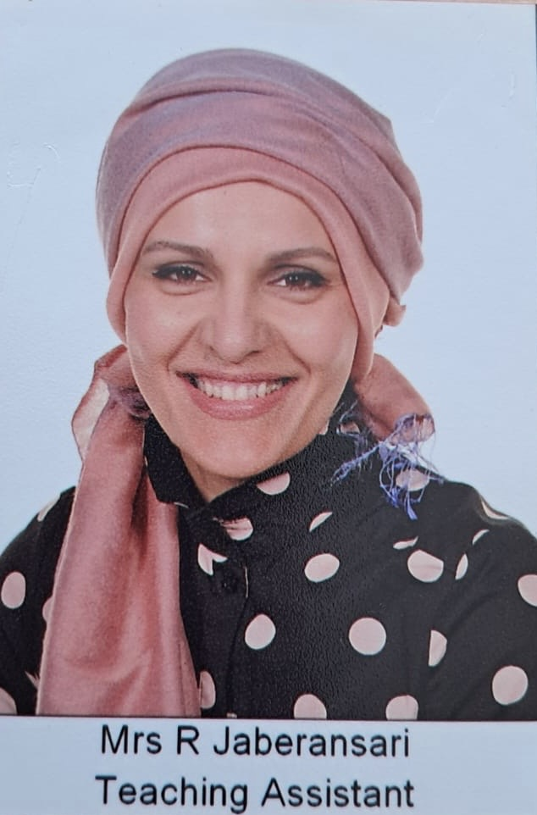
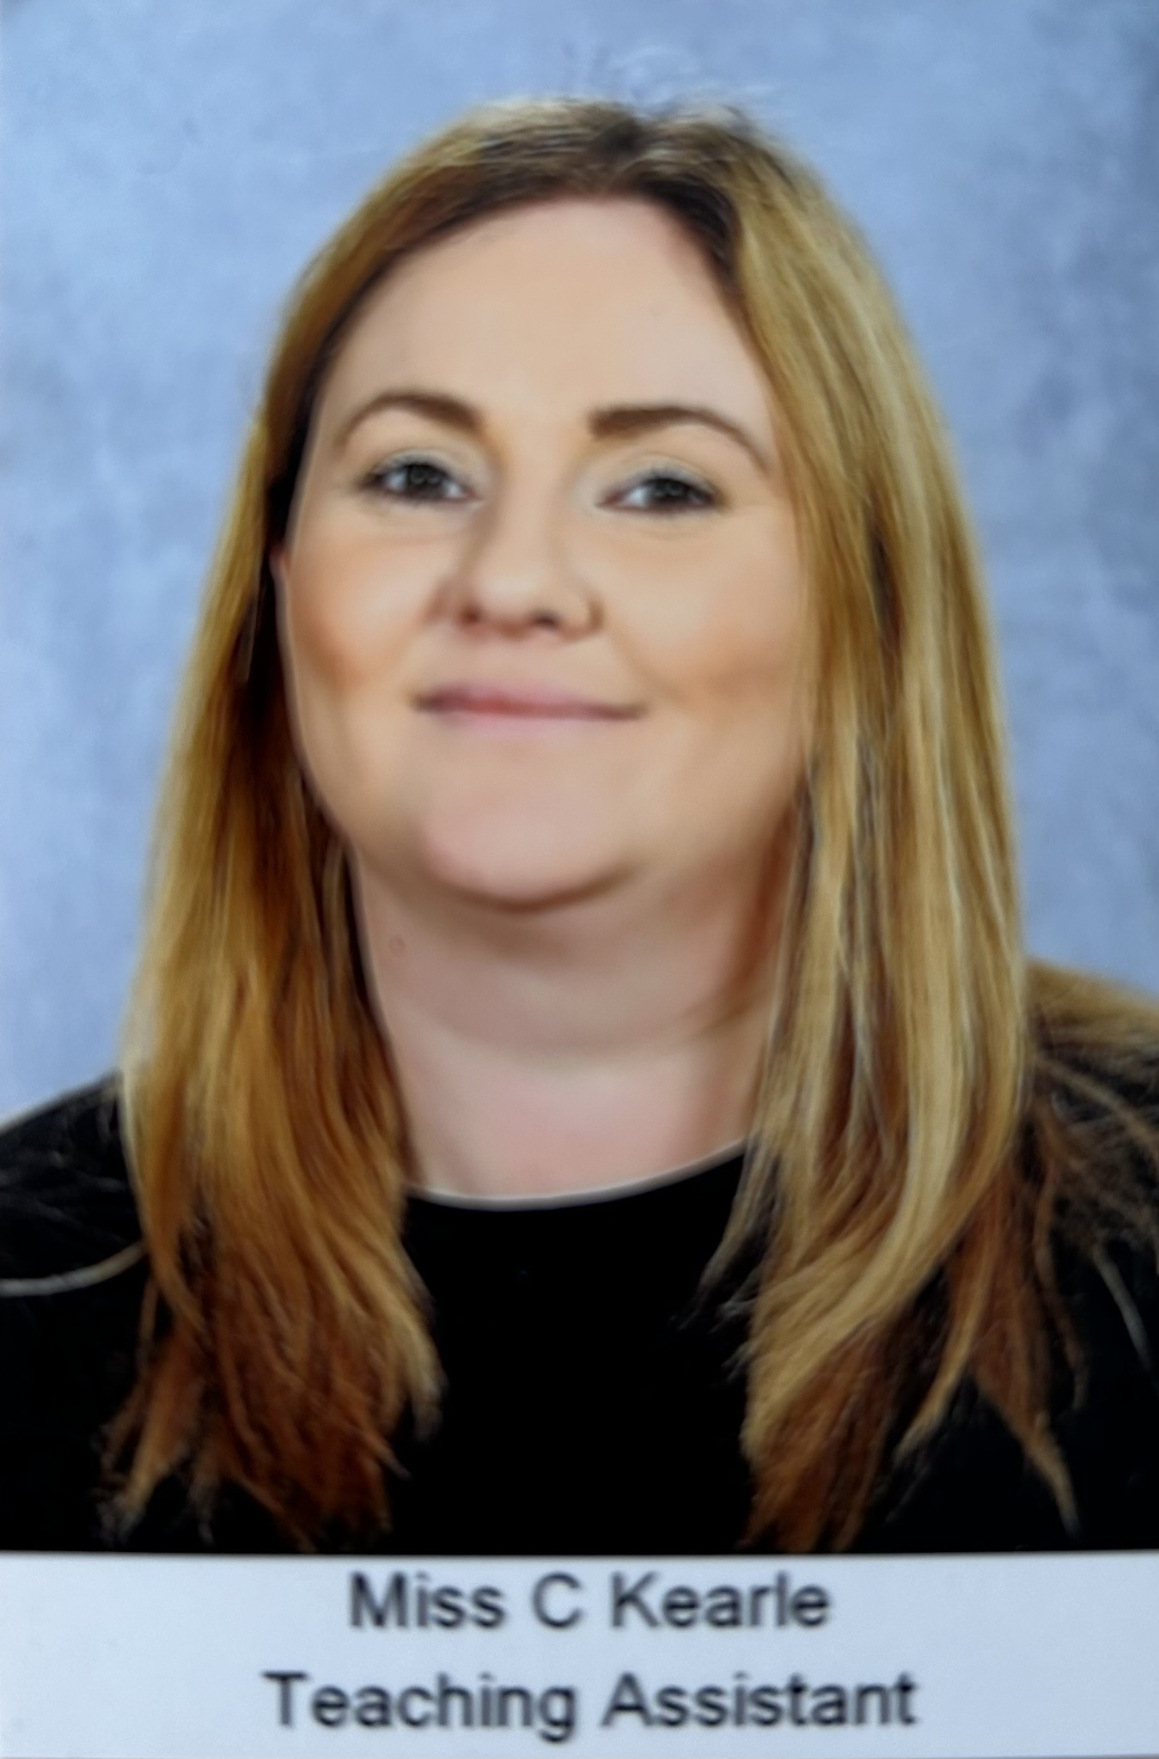
Meet the Reception Team
Tî m y Dosbarth Derbyn

Slide 4
RS Mrs Rayer/Mrs Street (RRS)
RE Mrs Evans/Mrs Street (RES)
Informal meeting
Start date
Admission forms
Birth certificates
Communication:
Arbor will be the main communication system for parents
Parent Pay is used by parents to book funded school dinners and school trips
Parents can email the school office for any queries LakesidePrimary@cardiff.gov.uk

Slide 5
Snack time
Amser Snac
We promote healthy eating at Lakeside Primary School
Your child can bring a piece of fruit for snack
They will be offered milk to drink
Your child may bring a bottle of water to drink
Please no nuts or sweets to school

Slide 6
Lunchtime
Amser Cinio
Lunchtime is from 11.45am until 1pm
Your child may have a funded school dinner or bring a packed lunch to school (Please do not sign your child for a school dinner and provide a packed lunch)
School meals need to be booked online - by 8am at the latest. Book these on Parent Pay
If your child has medically diagnosed special dietary needs, please let us know well in advance and arrangements can be made with the kitchen staff.
It would be very helpful if you make sure that your child is able to handle a knife, fork and spoon correctly, although staff are always willing to help when necessary

Slide 7








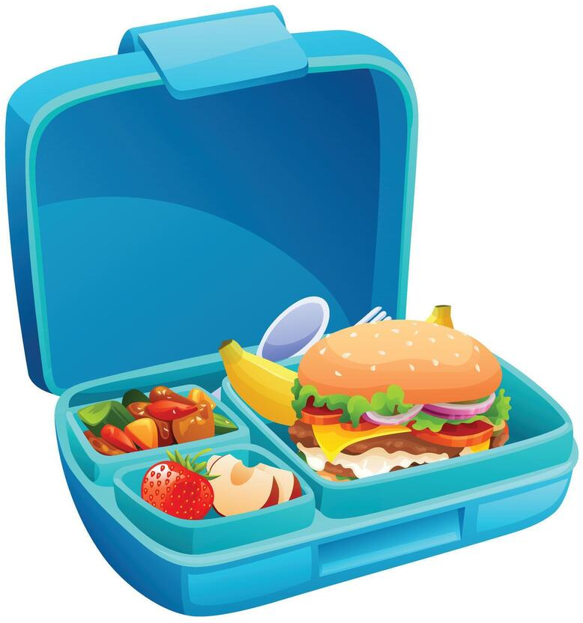




Make sure your child can use the toilet by themselves.
Help your child to use a knife, fork and spoon.
Sing rhymes and
songs with your child.
Read to your child to help develop a love of books.
Encourage your child to share and take turns.
Ways to help your child before starting school
Sut i helpu eich plentyn cyn dechrau yn yr ysgol
Help your child to practise putting on and taking off their own coat.
Encourage your child to try new foods.
Show your child how to open and close their lunch box and how to open wrappers and packaging on different foods.
Make sure your child can wash and dry their own hands.
Show your child how to take their shoes on and off. Velcro shoes are best.
Teach your child to say their name clearly when asked.
Show your child how to use scissors safely.

Slide 8
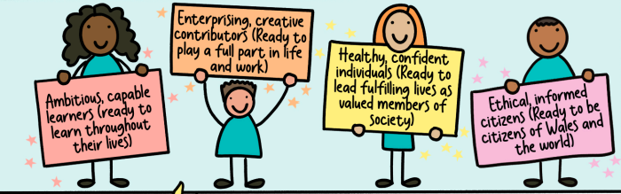
Why? Our Purpose & Vision for Learning
Pam? Ein pwrpas a’n gweledigaeth

Slide 9

What do we Teach and Learn in Reception?
Beth ydyn ni’n dysgu yn y Dosbarth Derbyn?

Slide 10
Learning Projects in Reception
Prosiectau Dysgu yn y Dosbarth Derbyn
Autumn Term: Getting to know you
Do you want to be friends?
Spring Term: Dangerous Dinosaurs
Puppets and Pop Ups
Summer Term: On the beach
On the Farm
Moving On

Slide 11
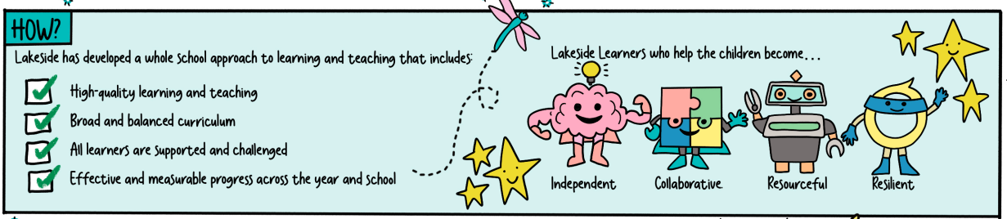
How?
Sut?
Every day the children have a focussed activity with the teacher and with the TA
For the focussed activities, children work in groups – this may be based on ability or mixed ability
The children also have access to the Enhanced provision, Continuous Provision and the Outdoor Learning area

Slide 12
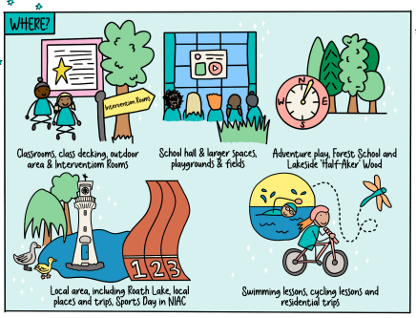
Where?
Ble?

Slide 13
How can I help my child at school?
Sut alla’i helpu fy mhlentyn?
Encourage your child to be independent e.g. when getting dressed, going to the toilet, washing their hands
Make sure your child is on time to start school - doors open 8.45am, close 8.55am (be aware of cameras and respectful of our school neighbours when parking)
Be on time to pick up your child - doors open 3.15pm
If your child is unable to attend school please phone the school office. Medication can only be given to a child in school with a letter from a medical professional. If your child has vomited or as had diarrhoea they must stay at home for at least 48 hours after the vomiting or diarrhoea has stopped or until they are better.
Make sure your child’s uniform has their name on it
Help them to foster an enjoyment of reading by reading to them and with them regularly
Help your child with their reading folder each week and help them with their online bug club reading
Look at numbers and words in the environment around them
Enjoy the outdoors together!

Slide 14


