Slide 1

Curriculum Meeting
Year 1
Learning and Living Together

Slide 2
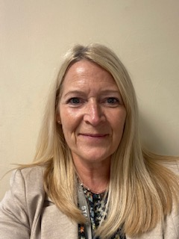
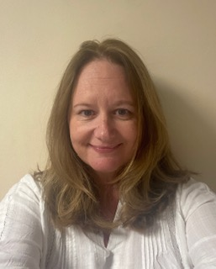
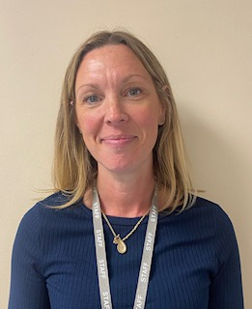
Meet The Year 1 Team

Slide 3
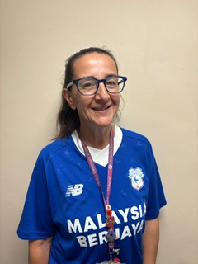
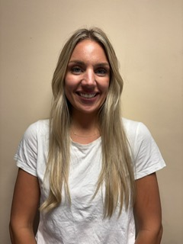
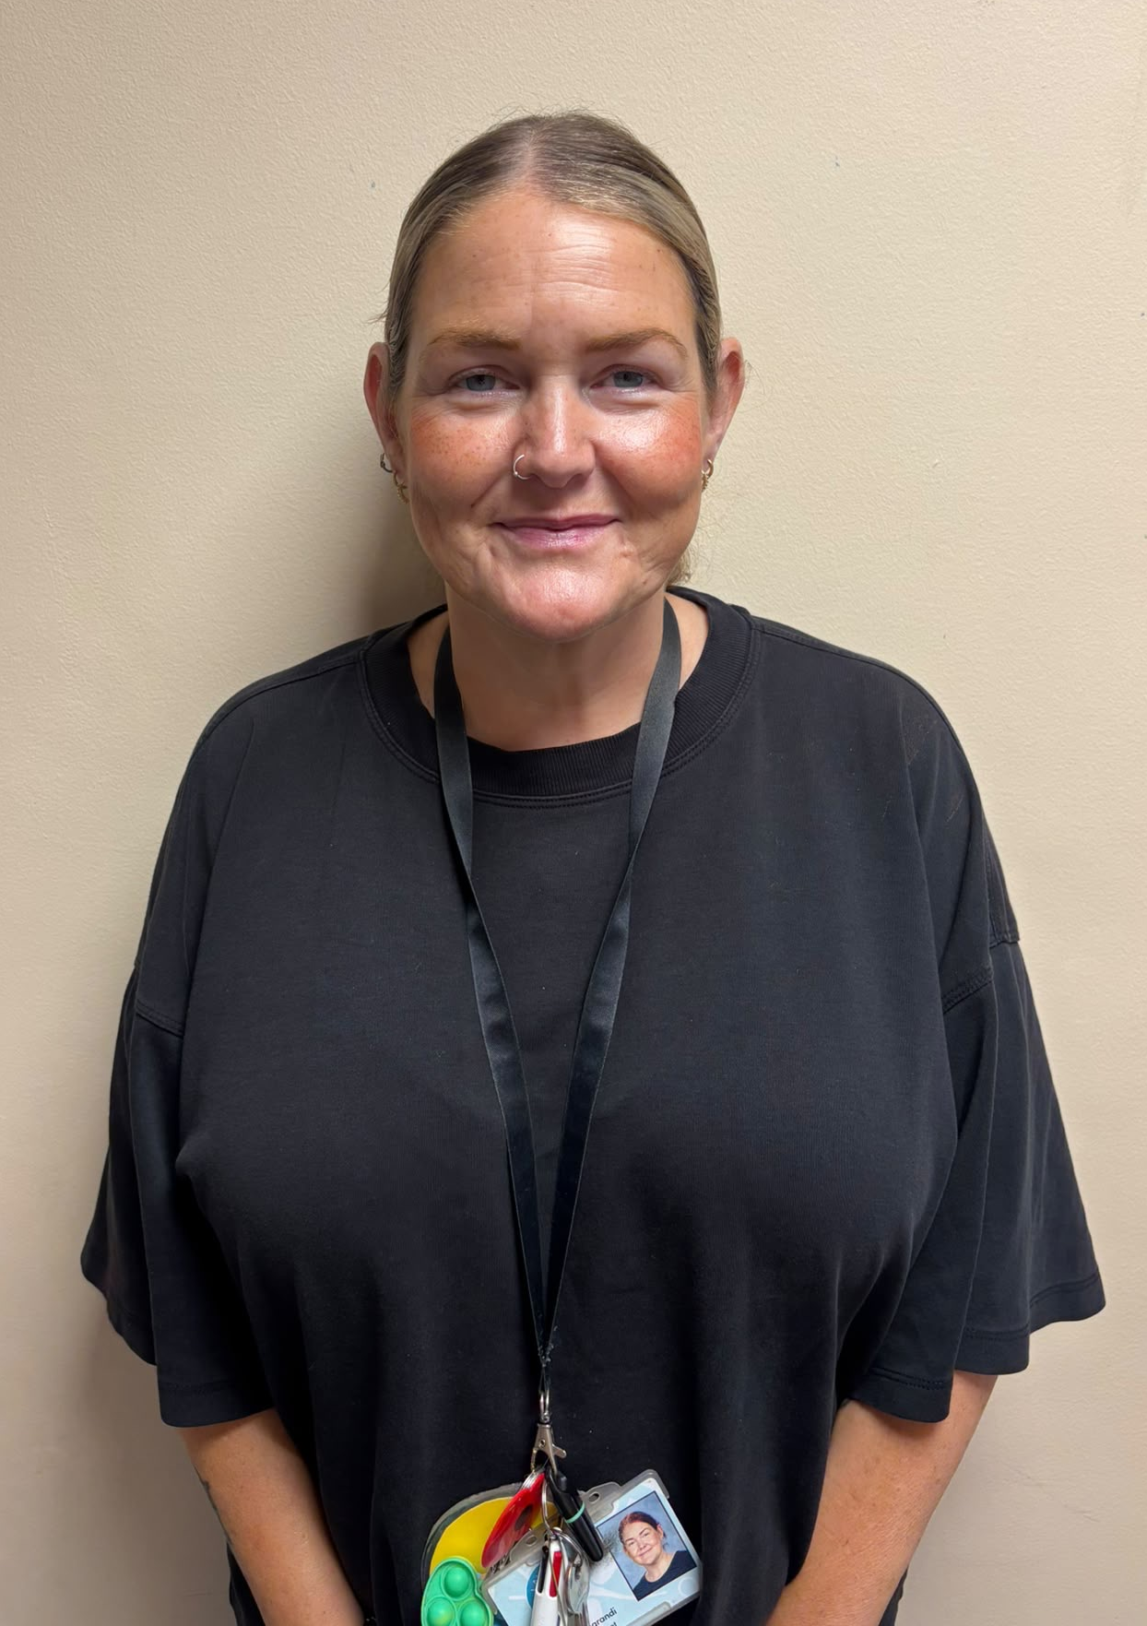
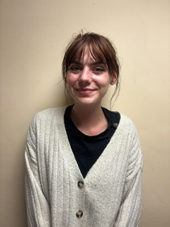
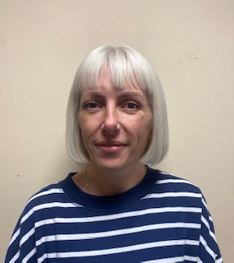
Meet The Year 1 Team

Slide 4
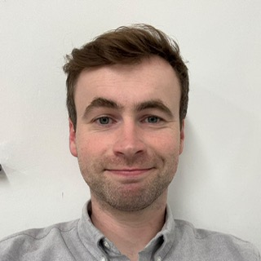
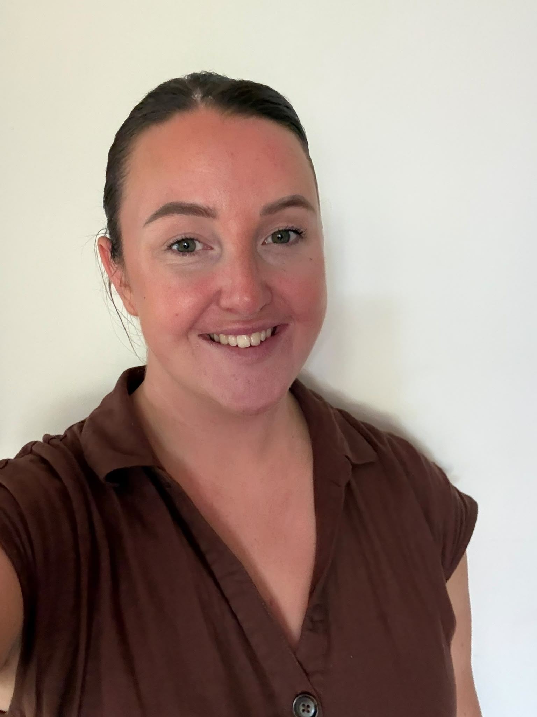
The School Team
PPA is every other Tuesday
PPA teachers: Mr Jones and Ms Parry
Our Estates Manager, who looks after the school building and property is Sean Carey
Our Office Manager is Lisa Green
Also in the office dealing with administration are Becky Strange and Rachel Rundle
School Catering Manager is Karen Harvey
Also have our morning and after school club Dragonflies - Manager is Katherine Allen
Mr Ben Jones
Ms Rachel Parry

Slide 5



Our School Values

Slide 6
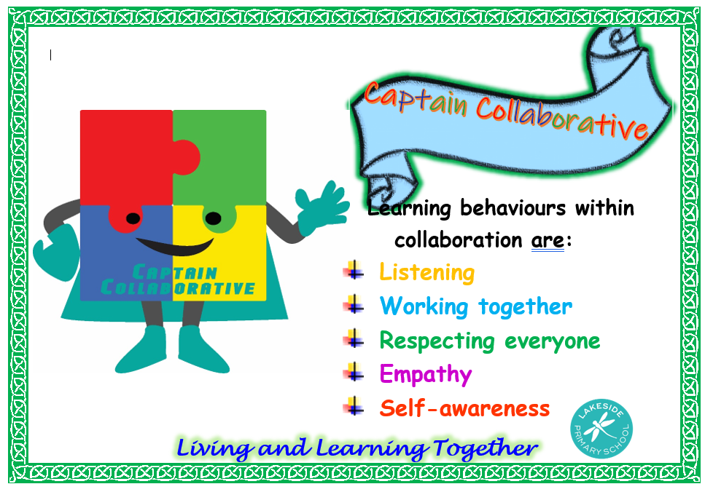
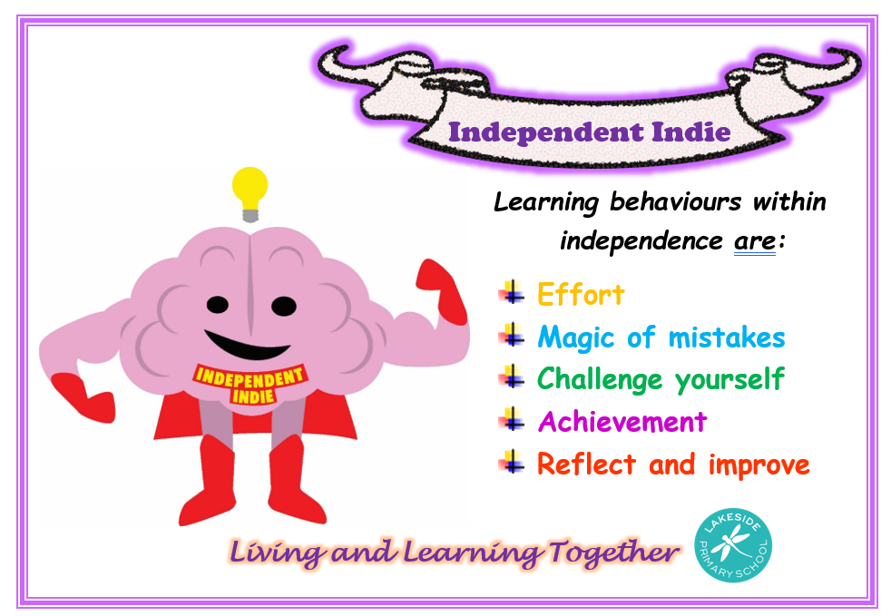
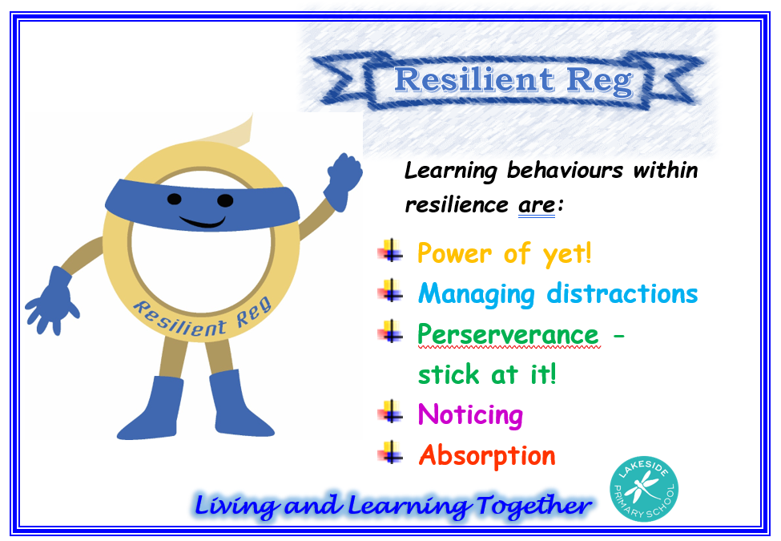
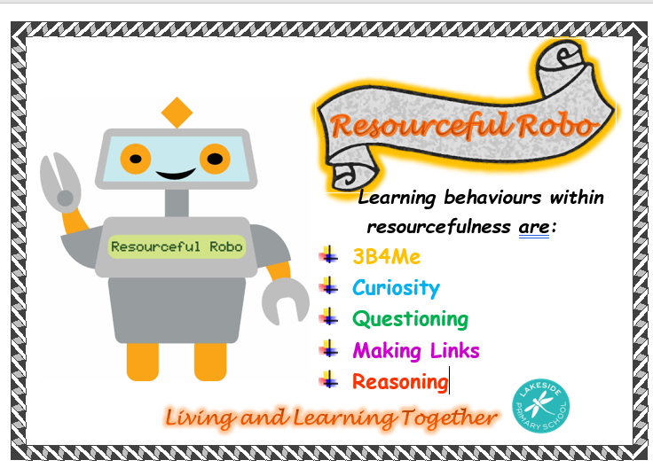
Our Lakeside Learners

Slide 7




Learning Projects in Year 1

Slide 8
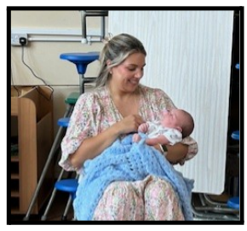
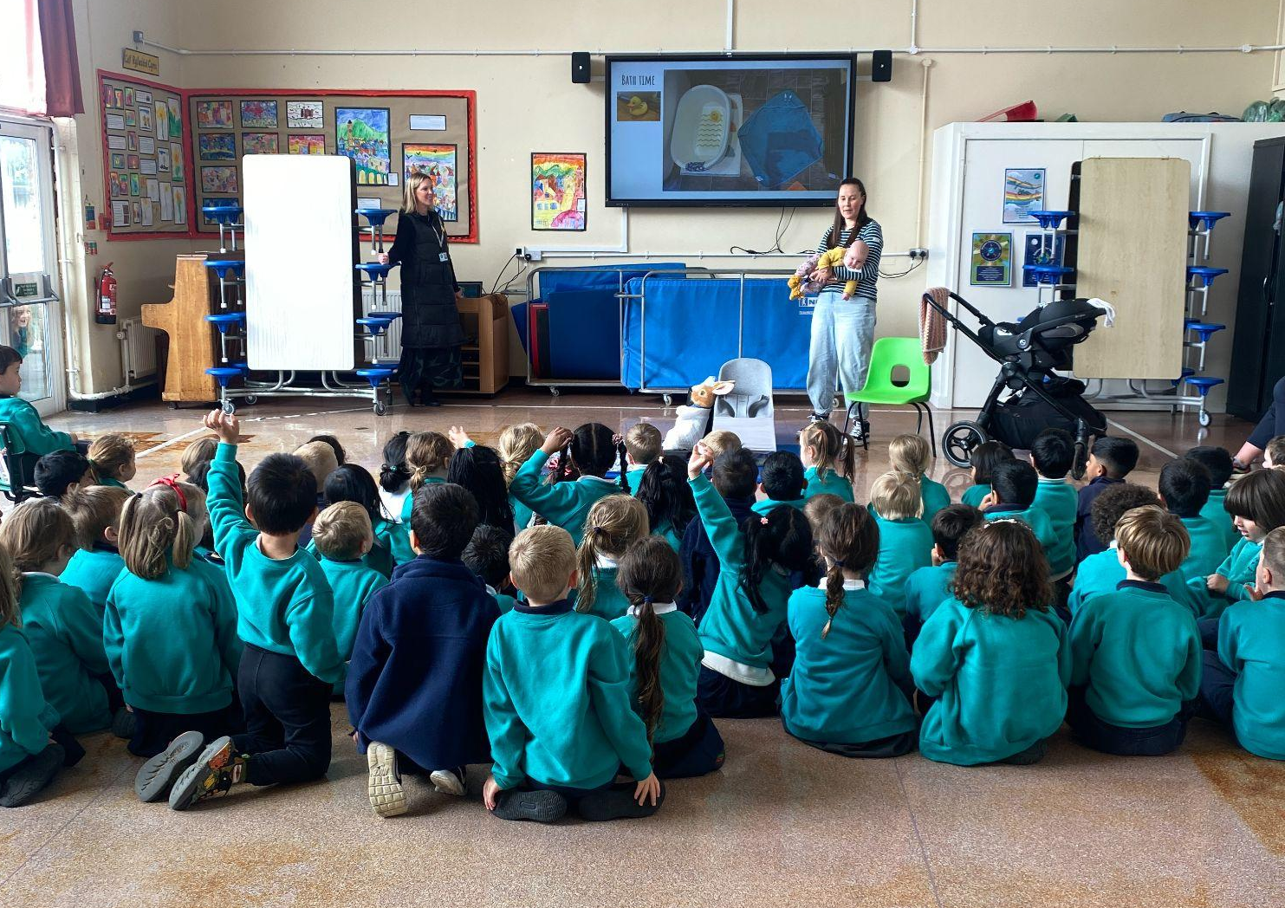
Memory Box
Engage : Memorable Experience
Meet the expert!

Slide 9
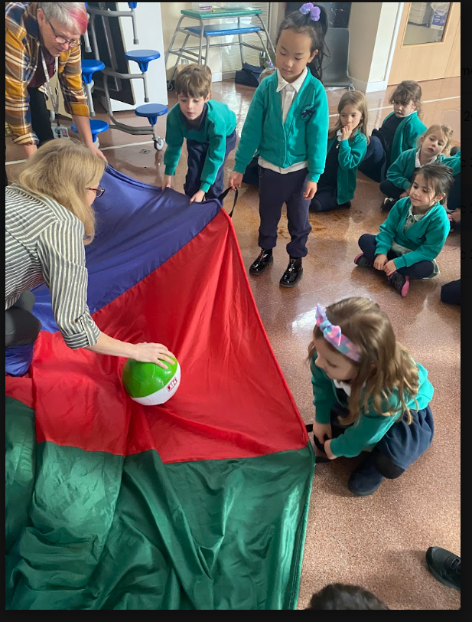
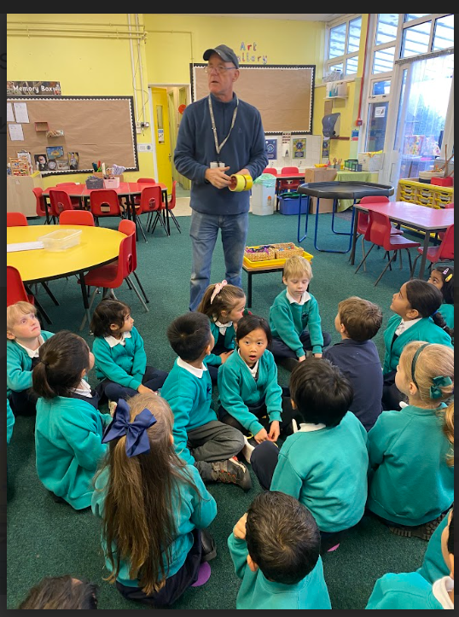
Moon Zoom
Engage:Memorable Experience
Meet the expert!

Slide 10
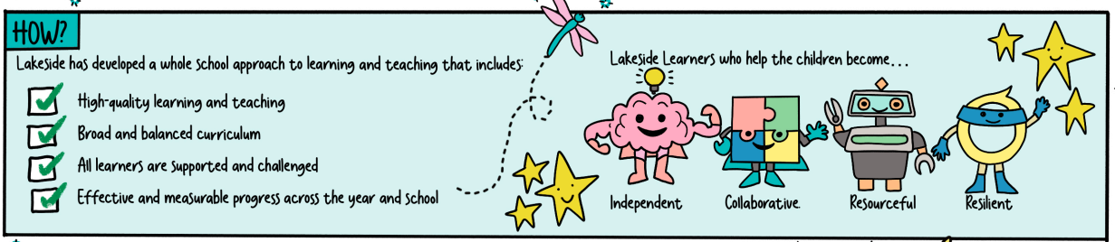
How is learning is organised?
Every day the children have a focussed activity with the teacher and with the TA
For the focussed activities, children work in groups – this may be based on ability or mixed ability
The children also have access to the Enhanced provision, Continuous Provision and the Outdoor Learning area

Slide 11
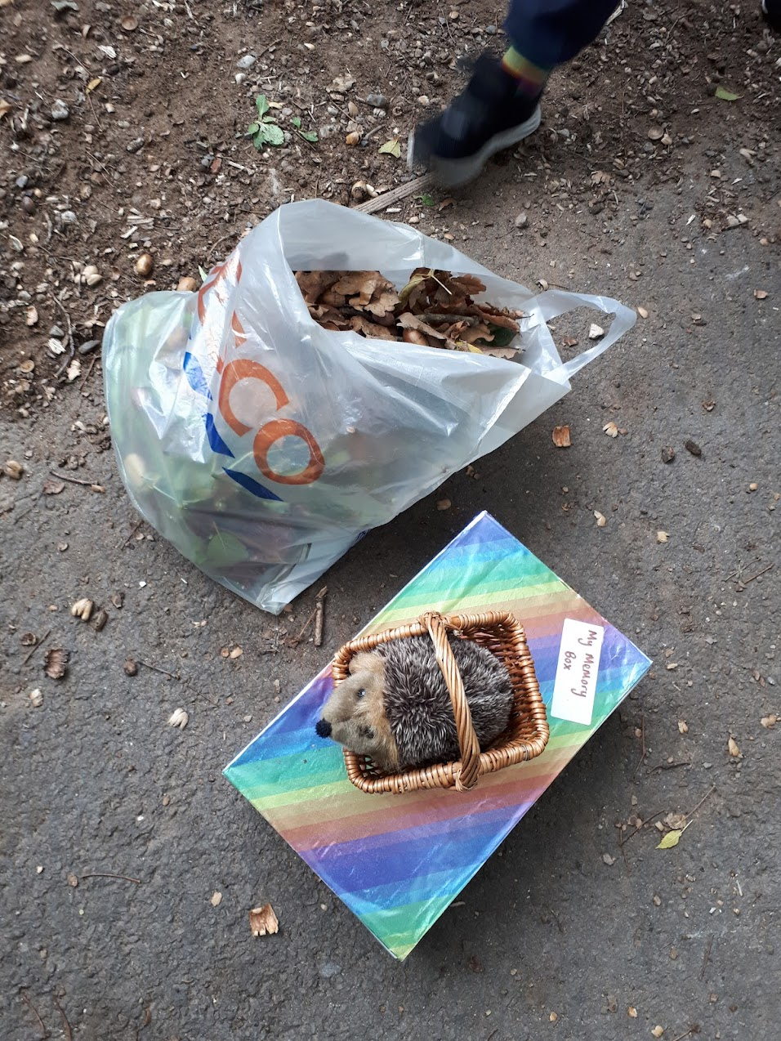
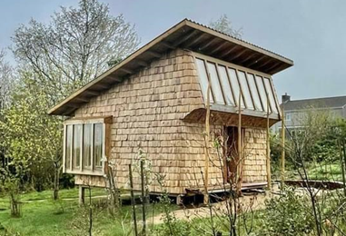
Outdoor Learning in Year 1
Ty Bronwen
Activities are planned to tie in with the current learning journey or to consolidate prior learning in different curriculum areas.

Slide 12
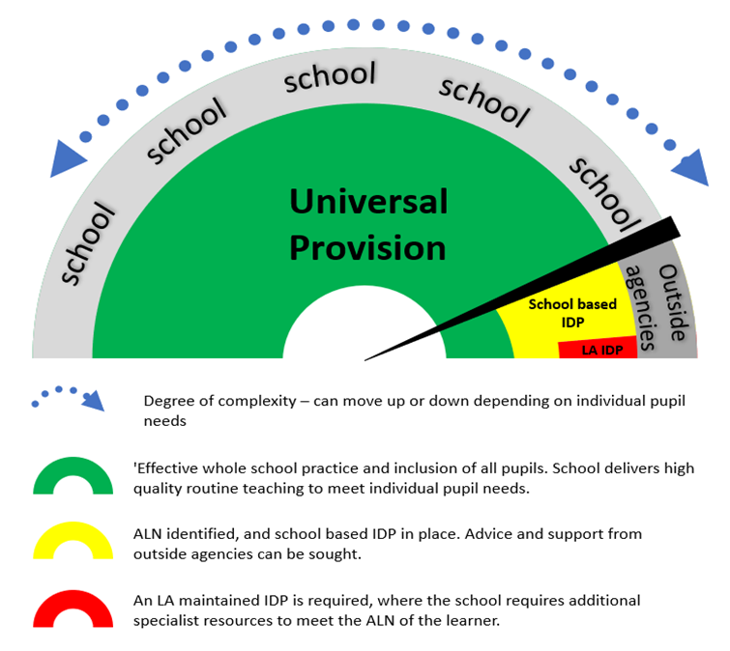
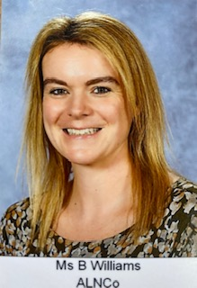
Additional Learning Needs
Most children and young people will make good progress and will not have Additional Learning Needs (ALN) or require Additional Learning Provision (ALP). The individual needs of these children and young people will be met within universal provision.

Slide 13



General information
Communication
Snack / School dinners
School Uniform
Attendance

Slide 14
How can I help my child?
Homework - what will this look like in Year 1?
Reading folder home every Friday, which is returned the following Wednesday or Thursday
If your child needs extra practise, they can also take home a daily reading folder (plastic wallet)
A book will regularly be assigned to their Bug Club online library - if you need a new login, please speak to your classteacher
Every term we will also send home their Big Maths and 100 words to practise
On the school website, there is a list of the maths skills that we are covering
Encourage your child to be independent e.g. when getting dressed
Enjoy the outdoors together!
Look at numbers and words in the environment around them

Slide 15

Reading and Monster Phonics
Learning to read is one of the most important skills a child will ever develop.
Monster Phonics teaches children to read in a clear, step-by-step way.
The programme follows a carefully planned sequence, introducing new sounds and spelling patterns at the right time so that every child can build on what they already know.
You can make a huge difference to your child's reading by spending just a few minutes each day reading together. Regular reading, practising phonics sounds and talking about books all help to build confidence and fluency.
To find out more about how Monster Phonics teaches reading and discover practical tips for supporting your child, visit the Monster Phonics Parent Information page: https://monsterphonics.com/phonics-support-for-parents/
https://monsterphonics.com/phonics-support-for-parents/#video-2

